Slide 1

CASH Alpha CIC Model
Presented by:
Data Science (Bhuvanesh, Pradeepa)
25th Aug 2025

Slide 2
Architecture Overview of TDB’s Risk Scorecards
For Cash Loan only
For both Cash and SIL
Limit Setting Model (Hosted in Digital Layer)
Credit Decisioning Model (Hosted in Taran)
Beta Stack
Alpha Stack
Trench 1: New Users - within 30 days from TSA Onboarding
Limit Setting Score = Gamma Stack
Beta Demo Score
Beta Demo Score
Gamma Demo Score
Apps Score
Apps Score
Selectively call Alpha
Apps Score
Credo Score
Users automatically move from Trench 1 to Trench 2 after 30 days if no disbursed loans
Credo Score
CIC Score
Gamma Income Model
Beta Income Model
Alpha Income Model
Users will stay in Trench 2 until 1st disbursed loan. His Gamma Stack will be re-calculated every 30-day anniversary from TSA onboarding date
Limit Setting Score = Gamma Stack
Beta Stack
Alpha Stack
Gamma Demo Score
Beta Demo Score
Beta Demo Score
Trench 2: Existing Users - After 30 days from TSA Onboarding AND Never Disbursed Loan
Apps Score
Apps Score
Selectively call Alpha
Apps Score
Transaction Score
Transaction Score
Transaction Score
CIC Score
Gamma Income Model
Beta Income Model
Alpha Income Model
Users will move to Trench 3 after 1st Disbursed Loan
Lowest Risk users from this B Score will be pre-approved for upsell and xsell. Medium Risk users from this B Score will have to go through Taran.
High Risk users from this B Score will not be given any offer.
B Score = Gamma Stack
Trench 3: Existing Users - After 30 days from 1st Disbursed Loan AND current DPD <= 10
Beta Stack
Alpha Stack
Gamma Demo Score
Apps Score
Beta Demo Score
Beta Demo Score
Apps Score
Apps Score
Enhanced Transaction Score
Selectively call Alpha
Enhanced Transaction Score
Once moved to Trench 3, user will forever remain in Trench 3. His Gamma Stack will be re-calculated every 30 days anniversary from 1st Loan Disbursement Date
Enhanced Transaction Score
CIC Score
Gamma Income Model
Beta Income Model
Alpha Income Model

Slide 3
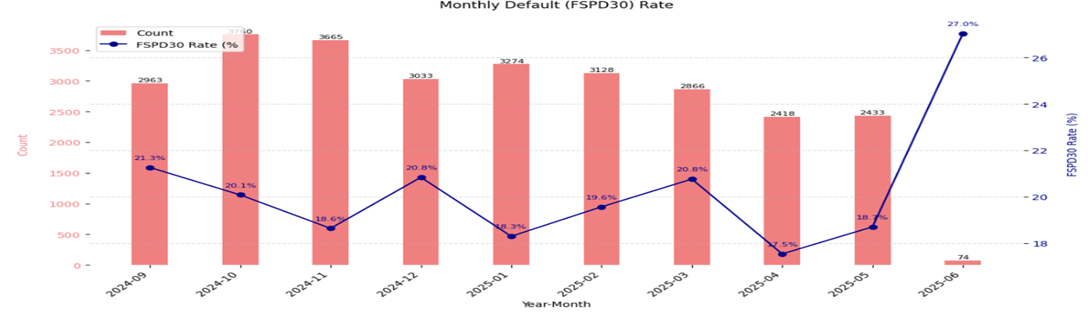
Cash Loan CIC Scorecard
 | Loan Disbursement Date | # Count | # Bad (FSPD30) Cash Loans | FSPD30 rate
Training (90%) | 01/09/2024 - 31/01/2025 | 15025 | 2965 | 0.1973
Validation (10%) | 01/09/2024 - 31/01/2025 | 1670 | 334 | 0.2
Test (Feb) | 01/02/2025 - 28/02/2025 | 3128 | 612 | 0.1957
OOT (Mar) | 01/03/2025 - 31/03/2025 | 2866 | 595 | 0.2076
OOT (Apr) | 01/04/2025 - 31/04/2025 | 2418 | 424 | 0.1754
OOT (May) | 01/05/2025 - 22/05/2025 | 2433 | 455 | 0.187
OOT(Jun) | 01/06/2025 - 30/06/2025 | 74 | 20 | 0.2703
3

Slide 4
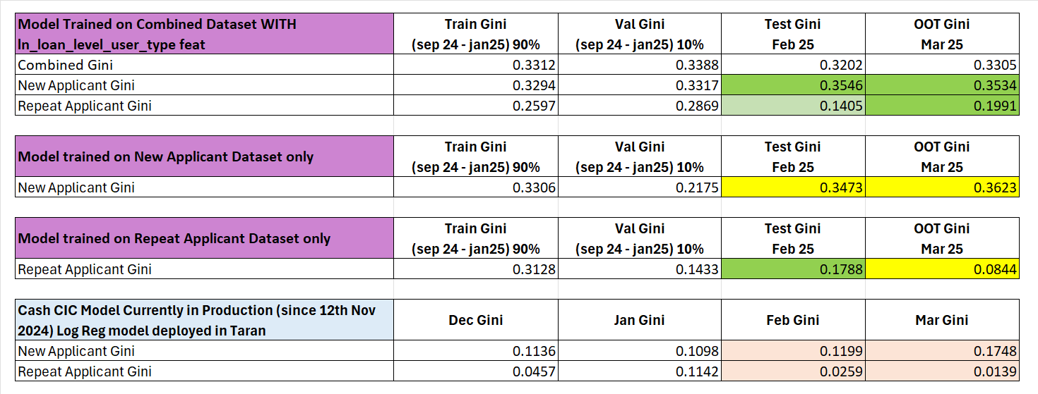
After lot of experimentations, the Model trained on combined dataset (new applicant + repeat applicant) along with the user_type feature showed the best performance and stability

Slide 5
Feature Selection Methodology Overview
Feature Selection Methodology Overview
166
Feats
112
Feats
103 Feats
60 Feats
13 Feats
Missing Rate < 95%
IV > 0.01
Inter-correlation < 75%
Individual Feature Evaluation
5

Slide 6
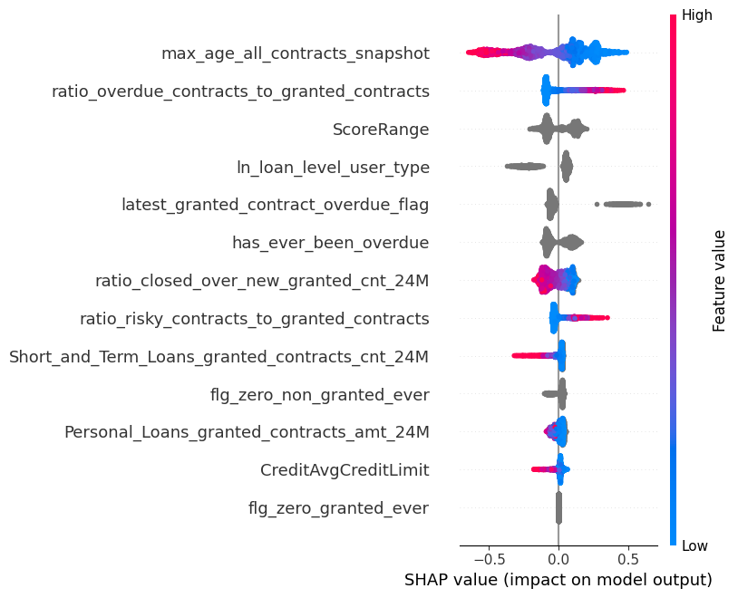
SHAP (13 feat)
The horizontal axis shows how much a feature affects the prediction. Points to the right mean the feature increases the prediction, and points to the left mean it decreases it.
The color of each dot shows the feature value: red means the value is high, and blue means the value is low. Grey means categorical feature.
If red dots are mostly on the right, it means high values of that feature increase Risk. If red dots are on the left, high values decrease Risk.
The features are listed on the vertical axis, from most important at the top to least important at the bottom.
6
Notes:
Descriptions need to be added

Slide 7
Feature Description
Feature Name | Feature Description
max_age_all_contracts_snapshot | Max age from all loans active or closed at the run time.​
ratio_overdue_contracts_to_granted_contracts | Proportion of granted contracts that were overdue.
ScoreRange | This feature is indicative of the overall risk score segment of the user from CRIF.​
ln_loan_level_user_type | Loan level user type “New Applicant” or “Repeat Applicant”​
has_ever_been_overdue | 1 if the account has ever had an overdue contract, otherwise 0.​
latest_granted_contract_overdue_flag | Indicates if the most recent granted contract was overdue (1 = Yes, 0 = No).​
ratio_closed_over_new_granted_cnt_24M | Ratio of the number of contracts closed in the last 6 months to the number of new contracts granted in the last 24 months.​
ratio_risky_contracts_to_granted_contracts | Ratio of the number of risky contracts to the number of contracts granted.​
Short_and_Term_Loans_granted_contracts_cnt_24M | Count of Short and Term Loans granted in the last 24 months.​​​
flg_zero_non_granted_ever | A flag (likely 1/0) that indicates whether the customer never had any loan applications rejected (i.e., non-granted contracts = 0).​​
Personal_Loans_granted_contracts_amt_24M | Total amount of Personal Loans granted in the last 24 months.​
CreditAvgCreditLimit | Average credit limit across all credit card lines: Total Credit Limit / Total Number of Credit Card Lines.​​
flg_zero_granted_ever | A flag that indicates the user never had any granted loans (i.e., granted contracts = 0).​​
7
Notes:
Descriptions need to be added

Slide 8
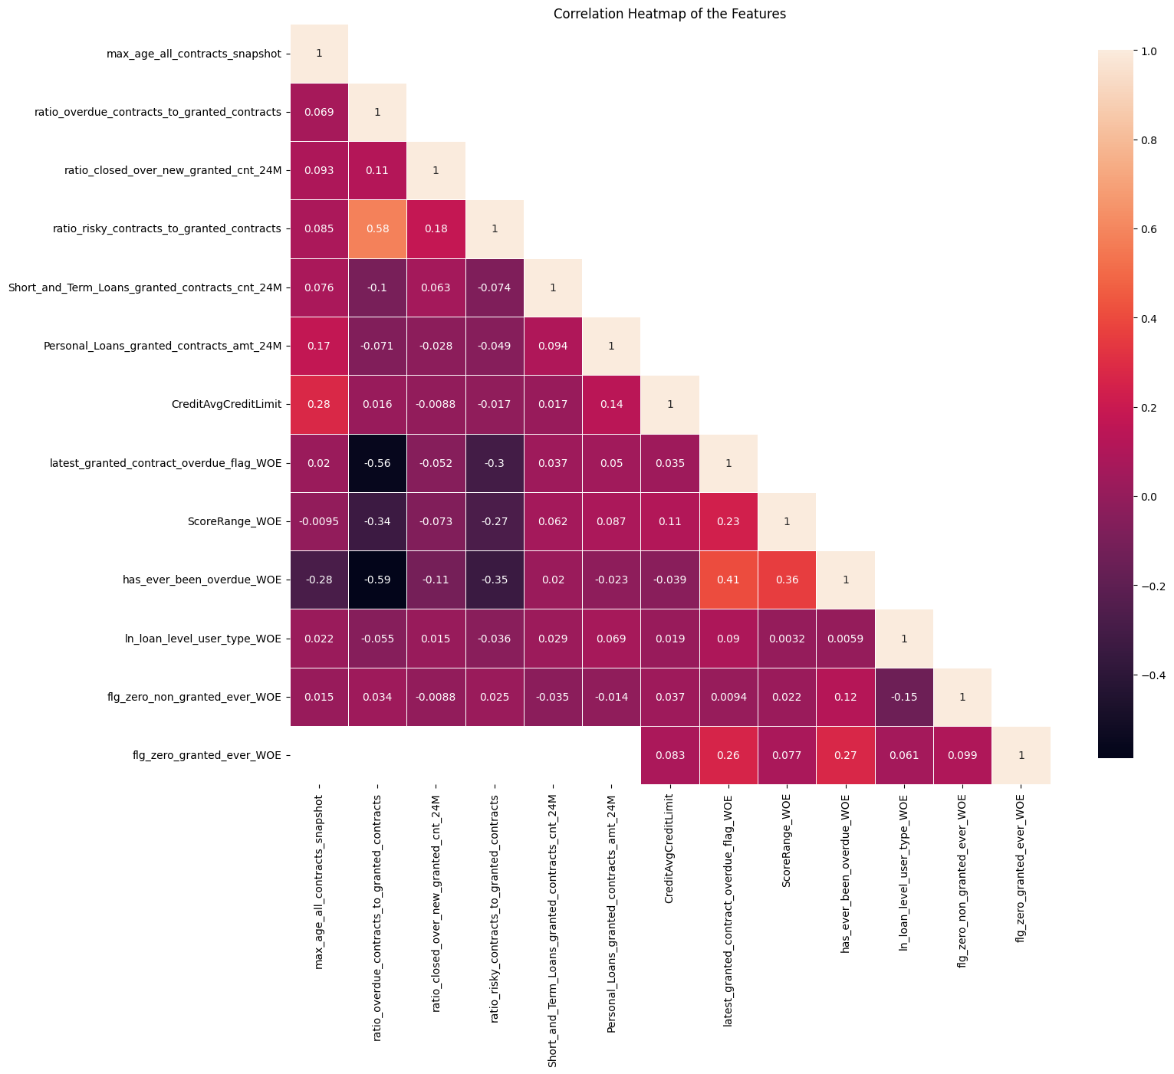
Inter-Correlation (13 feat)
The numbers show how strongly two features are related — values close to 1 mean a strong positive correlated (two features increase together), and values close to -1 mean a strong negative correlated (one feature increases while the other decreases).
Light-colored squares mean a stronger relationship, while dark ones mean weak or no relationship.
Most values here are small, so most features are not strongly related to each other — this is good for building models.
8
Notes:
Descriptions need to be added

Slide 9
Iteration | Features | Train Gini (Sep’24 - Jan'25) | Val Gini (Sep’24 - Jan'25) | Feb Gini | Mar Gini | Apr Gini | May Gini (until 18th)
1 | max_age_all_contracts_snapshot | 0.164354 | 0.167702 | 0.127177 | 0.158302 | 0.143692 | 0.202014
2 | ratio_overdue_contracts_to_granted_contracts | 0.282591 | 0.312004 | 0.278573 | 0.320151 | 0.269651 | 0.316644
3 | ScoreRange | 0.295658 | 0.308833 | 0.295267 | 0.331507 | 0.271704 | 0.324704
4 | ln_loan_level_user_type | 0.311268 | 0.330724 | 0.307579 | 0.335830 | 0.302535 | 0.349371
5 | has_ever_been_overdue | 0.308953 | 0.329186 | 0.308551 | 0.331692 | 0.304191 | 0.357703
6 | latest_granted_contract_overdue_flag | 0.314927 | 0.327463 | 0.314413 | 0.328488 | 0.302188 | 0.356997
7 | ratio_closed_over_new_granted_cnt_24M | 0.331039 | 0.342827 | 0.311580 | 0.322211 | 0.312440 | 0.354270
8 | ratio_risky_contracts_to_granted_contracts | 0.338026 | 0.346445 | 0.314921 | 0.330563 | 0.317198 | 0.360584
9 | Short_and_Term_Loans_granted_contracts_cnt_24M | 0.339043 | 0.340142 | 0.318627 | 0.334359 | 0.320878 | 0.359714
10 | flg_zero_non_granted_ever | 0.342472 | 0.341203 | 0.322166 | 0.337560 | 0.324371 | 0.358518
11 | Personal_Loans_granted_contracts_amt_24M | 0.355624 | 0.341549 | 0.323374 | 0.337864 | 0.328411 | 0.353424
12 | CreditAvgCreditLimit | 0.359433 | 0.342540 | 0.324177 | 0.336065 | 0.326416 | 0.358521
13 | flg_zero_granted_ever | 0.357845 | 0.339760 | 0.326708 | 0.336757 | 0.322506 | 0.361731
13 feature model after Hyper Parameters Tuning | New + Repeat Applicant | 0.3312 | 0.3388 | 0.3202 | 0.3305 | 0.3243 | 0.3545
 | New Applicant | 0.3294 | 0.3317 | 0.3546 | 0.3534 | 0.3012 | 0.3097
 | Repeat Applicant | 0.2597 | 0.2869 | 0.1405 | 0.1991 | 0.2815 | 0.3508
Hyperparameter | Value
learning_rate | 0.042148855624845966
depth | 5
l2_leaf_reg | 4.695427441749703
iterations | 2000
eval_metric | AUC
random_seed | 42
auto_class_weights | Balanced
early_stopping_rounds | 10
Hyperparameter values for the best model chosen after the HP Tuning using Optuna
9

Slide 10
SHAP Rank is overall Consistent Across Train, Test and OOT Datasets
Feature | Train Rank (Sep’24 – Jan’25) | Feb Rank | Mar Rank | Apr Rank
max_age_all_contracts_snapshot | 1 | 1 | 1 | 1
ratio_overdue_contracts_to_granted | 2 | 2 | 2 | 3
ScoreRange | 3 | 3 | 3 | 4
ln_loan_level_user_type | 4 | 4 | 4 | 2
has_ever_been_overdue | 5 | 5 | 5 | 5
latest_granted_contract_overdue_flag | 6 | 6 | 6 | 6
ratio_closed_over_new_granted_cnt | 7 | 7 | 7 | 7
ratio_risky_contracts_to_granted_contract | 8 | 8 | 8 | 8
flg_zero_non_granted_ever | 9 | 9 | 10 | 10
Short_and_Term_Loans_granted_contract | 10 | 10 | 9 | 9
Personal_Loans_granted_contracts_amount | 11 | 11 | 11 | 11
CreditAvgCreditLimit | 12 | 12 | 12 | 12
flg_zero_granted_ever | 13 | 13 | 13 | 13
10

Slide 11
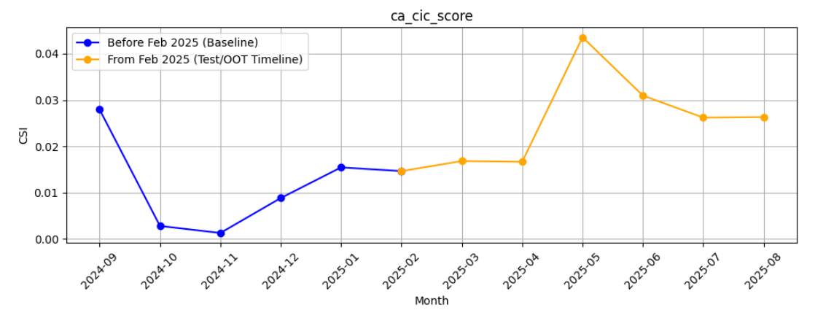
M-O-M Model PSI values (Baseline Training period) - Overall Applied
11

Slide 12
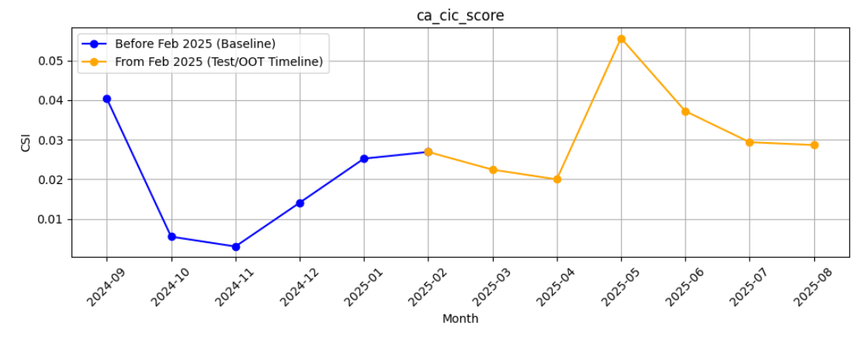
M-O-M Model PSI values (Baseline Training period) - Android Applied
12

Slide 13
M-O-M Model PSI values (Baseline Training period) - iOS Applied
13

Slide 14
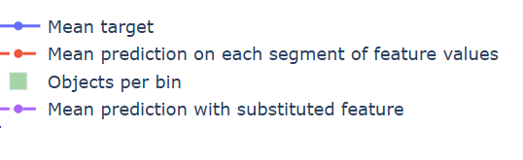
Feature Stability Plot Legend Table
 | Name | What It Shows | How to Interpret
Blue Line | Mean Target | The average true target value in each feature bin | If the line jumps around a lot, the target is unstable or noisy. If it moves smoothly, the target changes in a steady way.
Red Dashed Line | Mean Prediction | The model’s average prediction in each bin | Should generally follow the blue line. If it's a bit smoother, that means the model is generalizing well and avoiding overfitting.
Green Bars | Objects per Bin | The number of data points in each bin | Taller bars mean the signal is reliable. Very short bars mean there’s not much data, so predictions might be risky or unreliable.
Purple Dotted Line | Mean Prediction with Substituted Feature | What the model would predict if this feature was shuffled or replaced randomly | If it stays close to the red line, the model doesn’t rely much on this feature. If it's far from the red line, the model depends heavily on this feature.
14
Notes:
Descriptions need to be updated

Slide 15
Feature Evaluation Analysis (13 features)
15

Slide 16
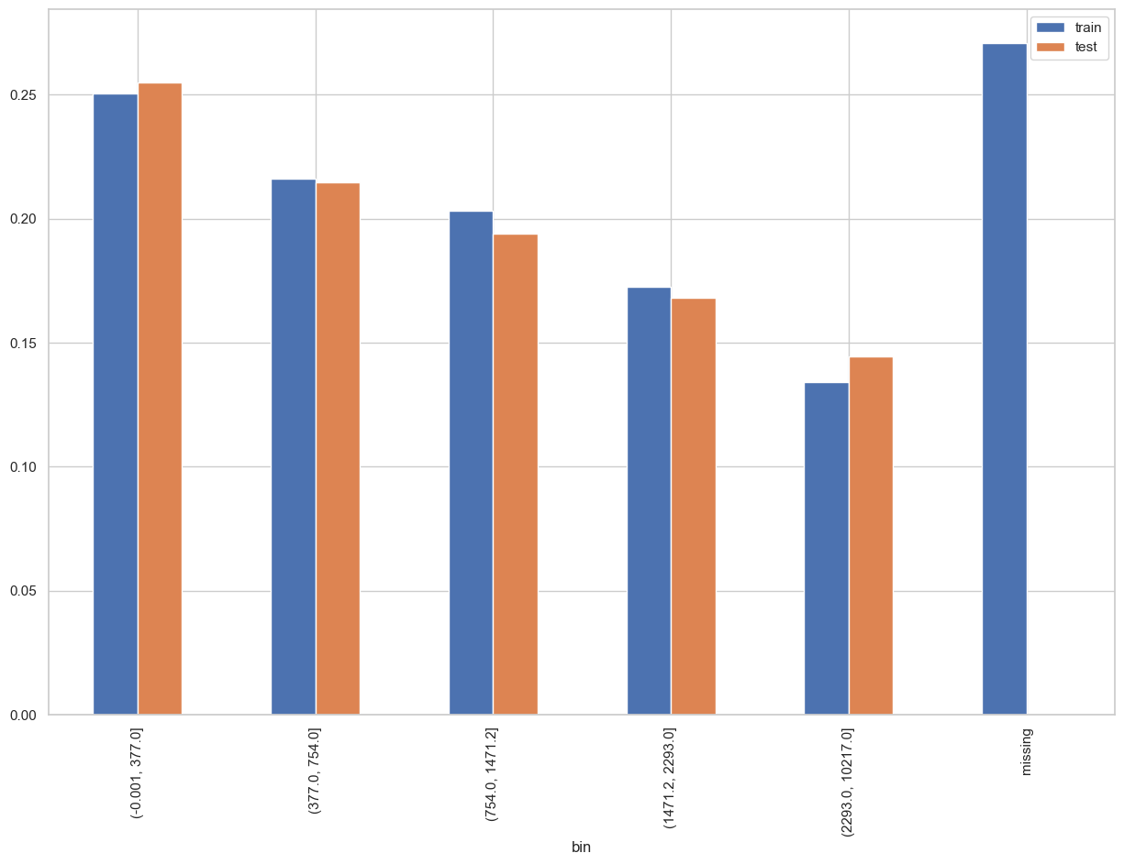
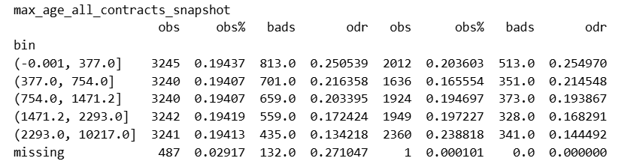
Rank# 1: max_age_all_contracts_snapshot (1 / 6) - Performance in Train vs Test <Disbursed>
Max age from all loans active or closed at the run time.
16
Please note these are just WOE Bins, NOT the final Bins that Catboost chooses internally

Slide 17
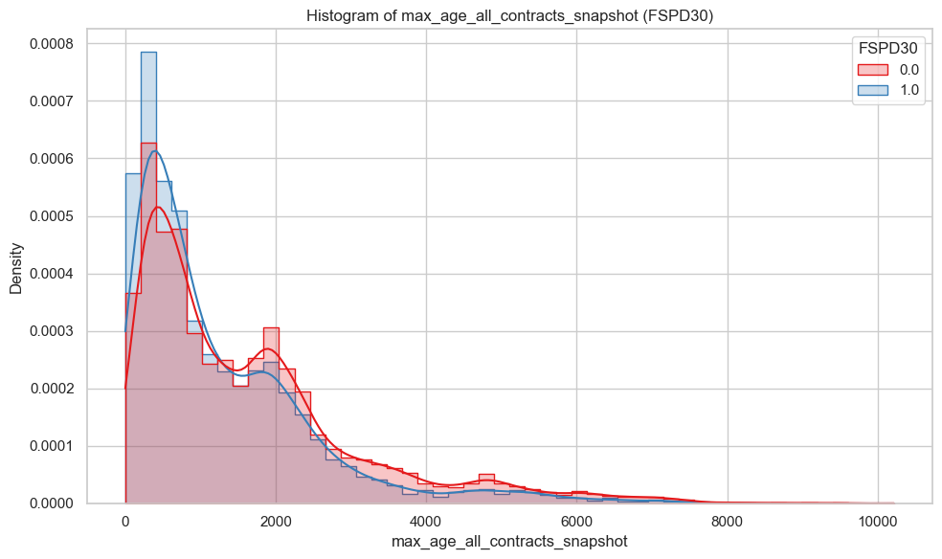
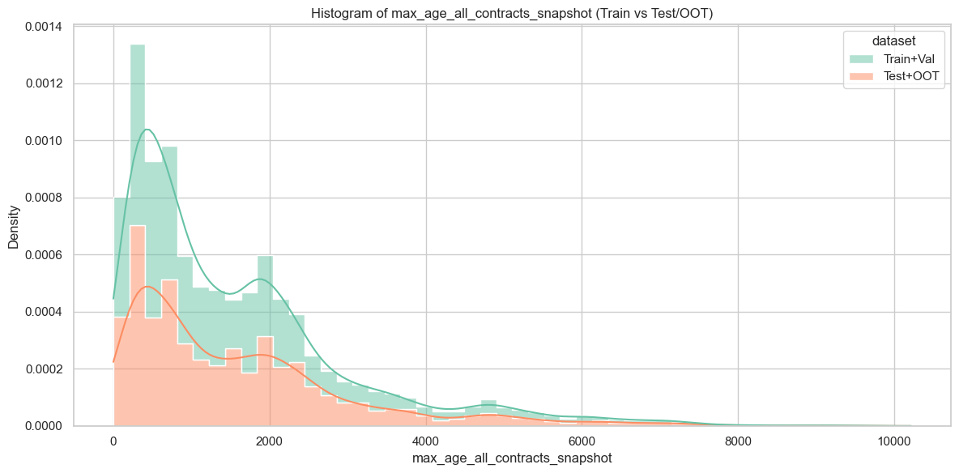
Rank# 1: max_age_all_contracts_snapshot (2 / 6) - Histogram <Disbursed>
Both Train+Val (green) and Test+OOT (orange) are right-skewed, with most contracts having relatively low ages. The density is highest near 0–500 and gradually tapers off as age increases. Test+OOT has lower peak density compared to Train+Val but follows the same overall pattern. Extreme ages (up to ~10,000) exist in both sets but are rare and don’t affect the general shape.
Both good (red) and bad (blue) customers show highly right-skewed distributions, concentrated in the early contract ages below ~2000. Bad customers (blue) peak slightly sharper near very young contract ages, while good customers (red) display a broader spread with secondary density humps extending toward mid-age ranges (~1500–2500). This indicates that longer, sustained credit histories are more common among good customers, whereas bad customers are more concentrated in relatively newer contracts.
17

Slide 18

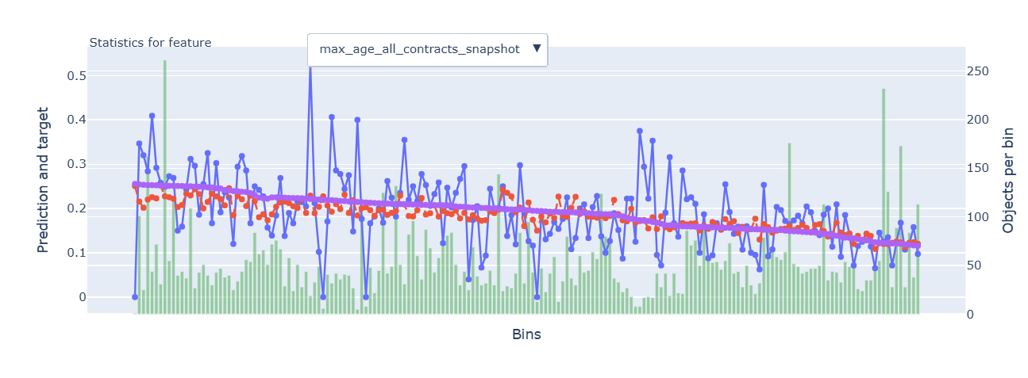
Rank# 1: max_age_all_contracts_snapshot (2 / 6) - Feature Statistics Analysis <Disbursed>​
The red (prediction) and blue (actual target) lines closely follow each other, indicating the model captures the feature's overall trend well.
The small gap between the red and purple lines suggests the feature adds value, with high predictive power.
The downward trend in the red line shows an inverse relationship with the target, confirming the feature's relevance in predicting risk.
18

Slide 19
Rank# 1: max_age_all_contracts_snapshot (4 / 6) - MoM Feature Distribution <Applied>​
month | max_age_all_contracts_snapshot |  | Avg. CIC Score
2024-09 | 893.18 |  | 0.54662
2024-10 | 1038.53 |  | 0.53066
2024-11 | 1054.52 |  | 0.53131
2024-12 | 1121.39 |  | 0.5256
2025-01 | 1096.56 |  | 0.52092
2025-02 | 1175.56 |  | 0.52169
2025-03 | 1088.41 |  | 0.52142
2025-04 | 1064.79 |  | 0.52051
2025-05 | 1112.43 |  | 0.51152
2025-06 | 1090.55 |  | 0.51759
2025-07 | 1072.72 |  | 0.51914
2025-08 | 1064.72 |  | 0.51919
The feature shows a strong and steady increase from 893.18 in Sep 2024 to a peak of 1175.56 in Feb 2025. This reflects a reliable upward trend over a significant period.
After the peak, the data experiences some minor fluctuations in Mar 2025 and Apr 2025, but the values quickly rebound and stabilize. This demonstrates that the data remains balanced and resilient over time.
Overall, this feature demonstrates a positive growth trend, with a reliable and stable distribution, making it a strong candidate for continued use in modeling.
19

Slide 20
Rank# 1: max_age_all_contracts_snapshot (5 / 6) - MoM Feature Distribution <Applied> <User Type wise> ​
max_age_all_contracts_snapshot - New Applicant
month | max_age_all_contracts_snapshot |  | Avg. CIC Score
2024-09 | 870.46 |  | 0.55412
2024-10 | 1022.57 |  | 0.53885
2024-11 | 1043.13 |  | 0.53941
2024-12 | 1099.72 |  | 0.53985
2025-01 | 1062.03 |  | 0.53411
2025-02 | 1146.12 |  | 0.53446
2025-03 | 1024.06 |  | 0.53894
2025-04 | 1008.4 |  | 0.53747
2025-05 | 1035.21 |  | 0.53004
2025-06 | 1032.86 |  | 0.53473
2025-07 | 1019.1 |  | 0.53564
2025-08 | 994.7 |  | 0.53535
max_age_all_contracts_snapshot - Repeat Applicant
month | max_age_all_contracts_snapshot |  | Avg. CIC Score
2024-09 | 1180.77 |  | 0.44008
2024-10 | 1212.91 |  | 0.43368
2024-11 | 1171.05 |  | 0.44165
2024-12 | 1244.89 |  | 0.43729
2025-01 | 1305.29 |  | 0.43457
2025-02 | 1368.82 |  | 0.43043
2025-03 | 1381.67 |  | 0.43417
2025-04 | 1321.91 |  | 0.43667
2025-05 | 1427.51 |  | 0.42893
2025-06 | 1359.49 |  | 0.43152
2025-07 | 1331.07 |  | 0.4342
2025-08 | 1408.22 |  | 0.43364
The max age shows a consistent and steady increase from 870.46 in Sep 2024 to 1146.12 in Feb 2025, reflecting a stable upward trend.
The minor fluctuations observed in 2025 (especially in Mar and Apr) are within expected variation, indicating that the data remains balanced and resilient over time.
Overall, this feature demonstrates positive growth with a reliable and stable distribution, making it a strong candidate for continued use in modeling new applicants.
The max age steadily increases from 1180.77 in Sep 2024 to 1427.51 in May 2025, with a slight dip in Jul 2025.
Fluctuations are minor and within an expected range, reflecting stable growth.
Overall, the feature shows consistent and reliable growth, making it strong for modeling.
20

Slide 21
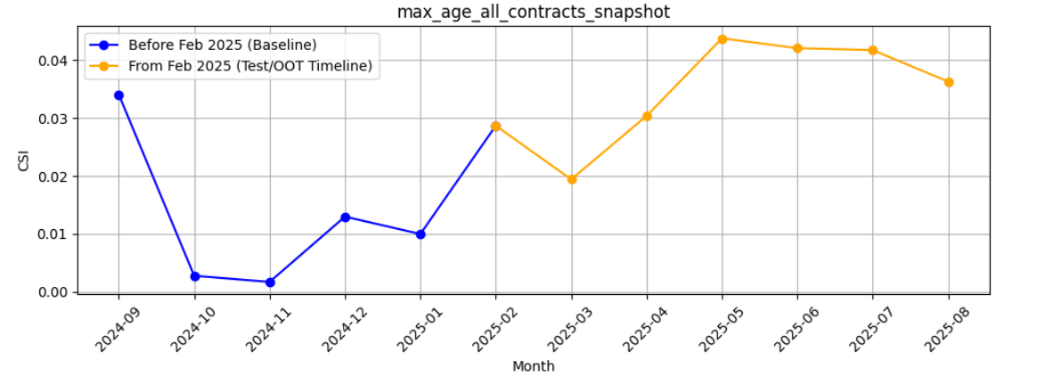
Rank# 1: max_age_all_contracts_snapshot (6 / 6) - Feature CSI Analysis <Applied>​
Baseline period: Sep’2024 to Jan’2025.
CSI for max_age_all_contracts_snapshot started high (~0.34 in Sep’24), then dropped sharply (<0.01 in Oct–Nov) and stayed low (~0.01–0.02) till Jan’25, showing good stability.
In the Test/OOT period (Feb–Jul’25), CSI rose from ~0.03 to ~0.044. Values remain below 0.1 (no drift), but the upward trend suggests mild variability to watch.

Slide 22
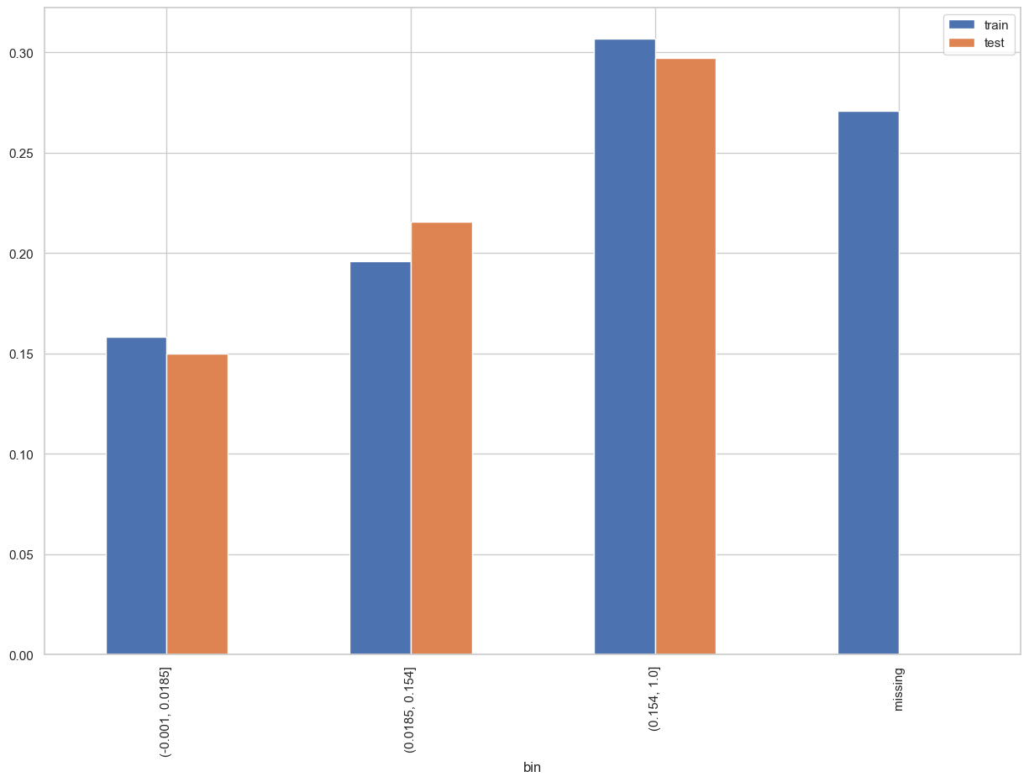
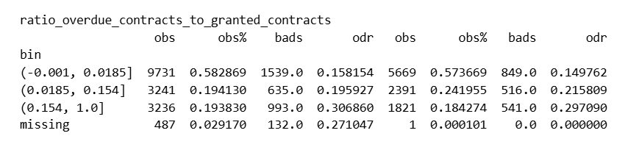
Rank# 2: ratio_overdue_contracts_to_granted_contracts (1 / 6) - Performance in Train vs Test <Disbursed>
Proportion of granted contracts that were overdue.
22
Please note these are just WOE Bins, NOT the final Bins that Catboost chooses internally

Slide 23
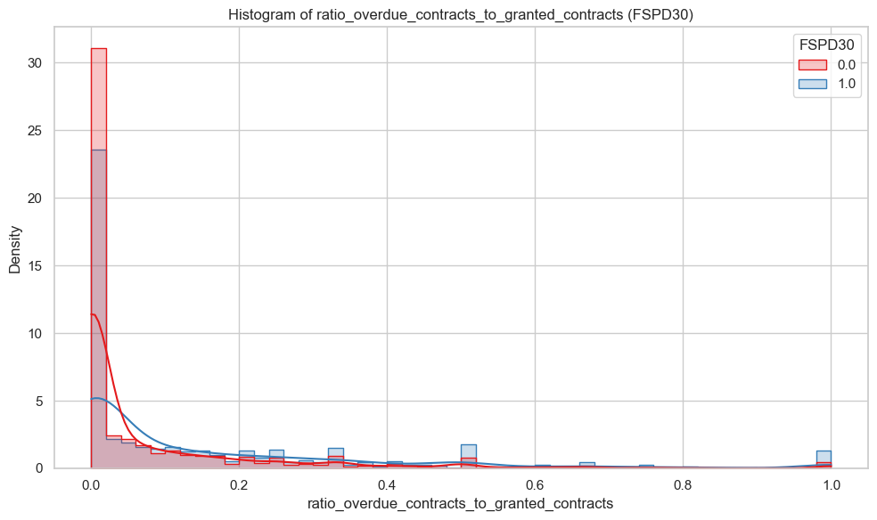
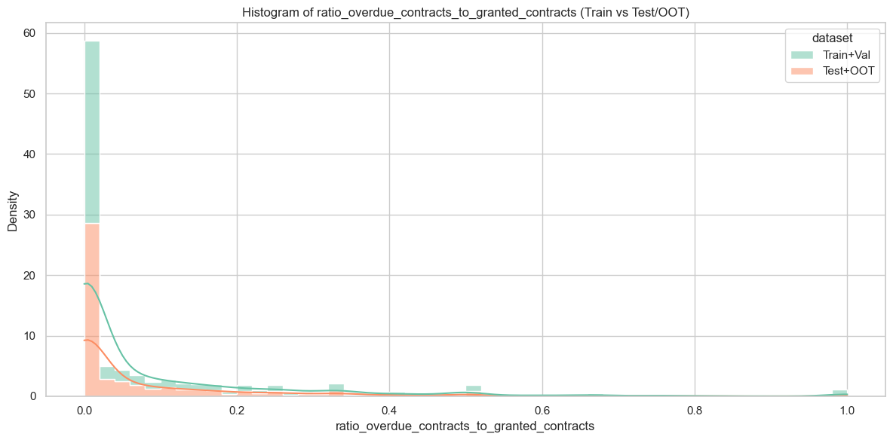
Rank# 2 ratio_overdue_contracts_to_granted_contracts (2 / 6) - Histogram <Disbursed>
The vast majority of customers have a very low ratio (close to 0). The shape is heavily right-skewed, with only a few customers having a higher proportion of overdue contracts.Test+OOT (orange) closely follows Train+Val (green), showing strong alignment and minimal distribution drift. This indicates that the data used for testing and out-of-time validation is representative of the training data.
Both good (red) and bad (blue) customers are concentrated near zero overdue ratios. Good customers have a stronger peak at zero, while bad customers have a flatter curve and more spread into the 0.05–0.3 range, highlighting a clear behavioral separation where lower overdue activity is more typical of good customers.
23

Slide 24
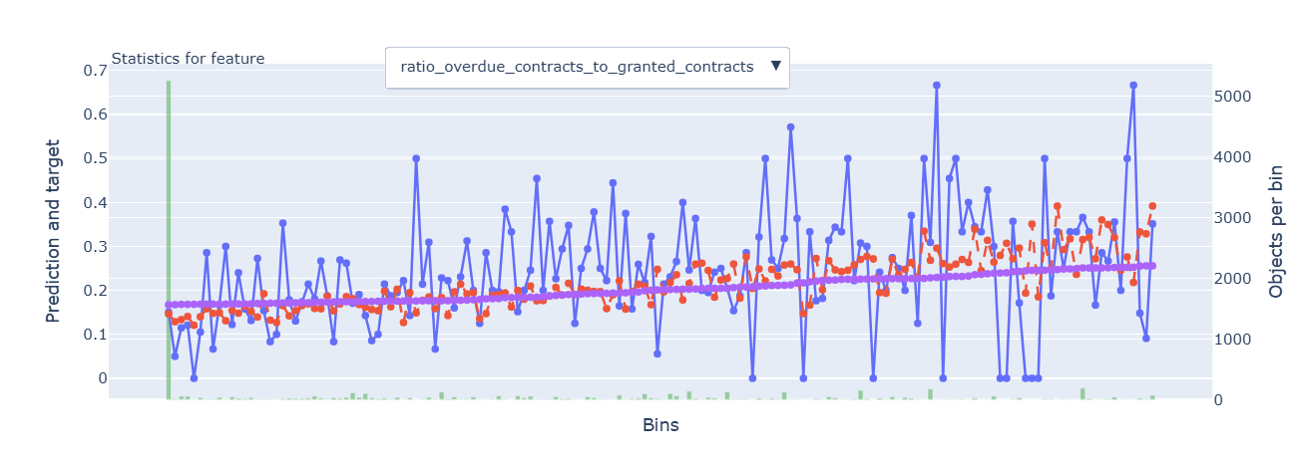
Rank# 2: ratio_overdue_contracts_to_granted_contracts(3 / 6) - Feature Statistics Analysis <Disbursed>​
The red (prediction) and blue (actual target) lines closely follow each other, indicating the model effectively captures the feature's overall trend.
The small gap between the red and purple lines suggests the feature adds some predictive value, but with moderate strength.
There is an upward trend in both the red and blue lines, confirming the feature's positive correlation with the target, where a higher ratio indicates increased risk.
24

Slide 25
Rank# 2: ratio_overdue_contracts_to_granted_contracts(4 / 6) - MoM Feature Distribution <Applied>​
month | ratio_overdue_contracts_to_granted_contracts |  | Avg. CIC Score
2024-09 | 0.17 |  | 0.54662
2024-10 | 0.15 |  | 0.53066
2024-11 | 0.15 |  | 0.53131
2024-12 | 0.15 |  | 0.5256
2025-01 | 0.14 |  | 0.52092
2025-02 | 0.14 |  | 0.52169
2025-03 | 0.14 |  | 0.52142
2025-04 | 0.13 |  | 0.52051
2025-05 | 0.12 |  | 0.51152
2025-06 | 0.13 |  | 0.51759
2025-07 | 0.13 |  | 0.51914
2025-08 | 0.13 |  | 0.51919
The ratio consistently shows a gradual decrease, starting from 0.17 in Sep 2024 and steadily improving to 0.12 by May 2025, before stabilizing around 0.13 in the following months.
This steady reduction reflects an overall improvement in overdue behavior, indicating that contracts are becoming more reliable and the risk is gradually decreasing over time.
The minor fluctuations between Jun 2025 and Jul 2025 are well within the expected variation, and the overall trend remains highly positive, reflecting the ongoing progress in overdue contract management.

Slide 26
Rank# 2: ratio_overdue_contracts_to_granted_contracts (5 / 6) - MoM Feature Distribution <Applied> <User Type wise> ​
ratio_overdue_contracts_to_granted_contracts -New Applicant
month | ratio_overdue_contracts_to_granted_contracts |  | Avg. CIC Score
2024-09 | 0.18 |  | 0.55412
2024-10 | 0.16 |  | 0.53885
2024-11 | 0.16 |  | 0.53941
2024-12 | 0.17 |  | 0.53985
2025-01 | 0.15 |  | 0.53411
2025-02 | 0.15 |  | 0.53446
2025-03 | 0.15 |  | 0.53894
2025-04 | 0.14 |  | 0.53747
2025-05 | 0.13 |  | 0.53004
2025-06 | 0.14 |  | 0.53473
2025-07 | 0.14 |  | 0.53564
2025-08 | 0.14 |  | 0.53535
ratio_overdue_contracts_to_granted_contracts- Repeat Applicant
month | ratio_overdue_contracts_to_granted_contracts |  | Avg. CIC Score
2024-09 | 0.08 |  | 0.44008
2024-10 | 0.07 |  | 0.43368
2024-11 | 0.08 |  | 0.44165
2024-12 | 0.07 |  | 0.43729
2025-01 | 0.08 |  | 0.43457
2025-02 | 0.07 |  | 0.43043
2025-03 | 0.08 |  | 0.43417
2025-04 | 0.09 |  | 0.43667
2025-05 | 0.08 |  | 0.42893
2025-06 | 0.08 |  | 0.43152
2025-07 | 0.08 |  | 0.4342
2025-08 | 0.08 |  | 0.43364
The ratio steadily decreases from 0.18 in Sep 2024 to 0.13 in May 2025, with slight fluctuations.
The changes are gradual and consistent, indicating stable improvement over time.
Overall, the feature shows controlled and reliable progress, making it strong for modeling.
The ratio fluctuates between 0.07 and 0.09, remaining stable throughout the months with no significant changes.
Minor fluctuations occur in Apr 2025, but the overall trend is consistent and predictable.
Overall, the feature shows stable behavior, making it reliable for modeling.
26

Slide 27
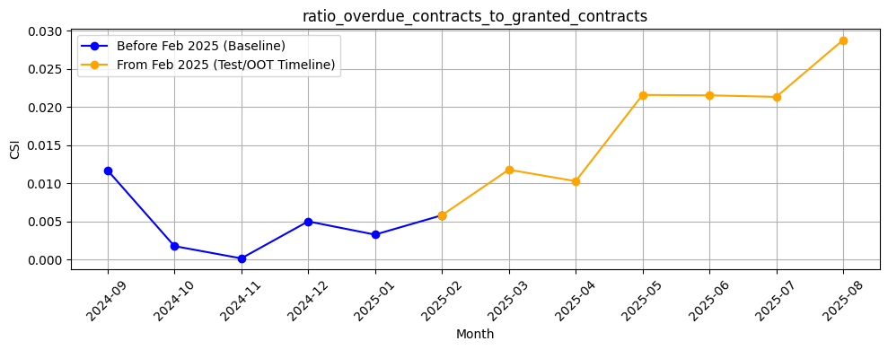
Rank# 2: ratio_overdue_contracts_to_granted_contracts(6 / 6) - Feature CSI Analysis <Applied>​
Baseline period: Sep’2024 to Jan’2025.
CSI for ratio_overdue_contracts_to_granted_contracts stayed very low, dropping from ~0.012 in Sep’24 to near zero in Oct–Nov, and remained <0.01 till Jan’25, showing strong stability.
In the Test/OOT period (Feb–Jul’25), CSI rose gradually from ~0.006 to ~0.022. Still well below 0.1 (no drift), but the steady upward trend suggests mild variability to monitor.

Slide 28
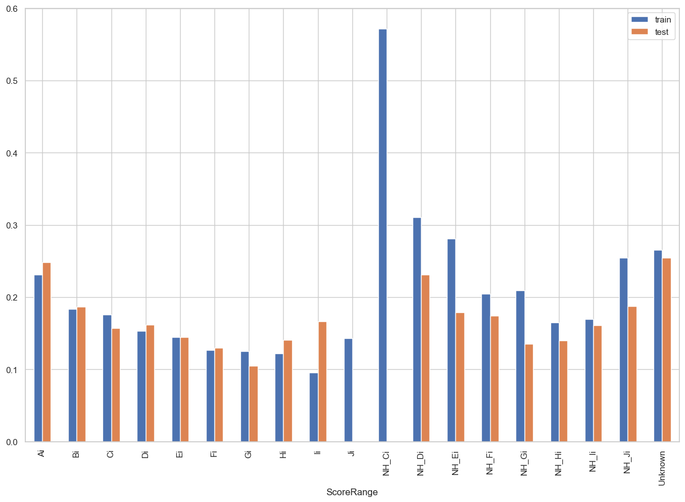
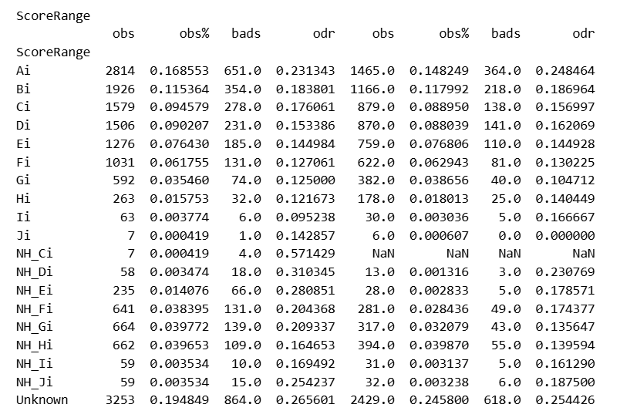
Rank# 3: ScoreRange(1 / 5) - Performance in Train vs Test <Disbursed>
This feature is indicative of the overall risk score segment of the user from CRIF.
28
Please note these are just WOE Bins, NOT the final Bins that Catboost chooses internally

Slide 29
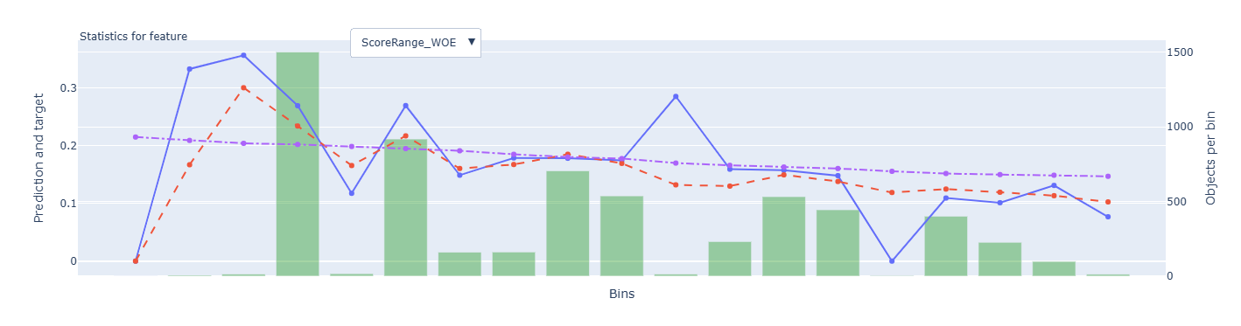
Rank# 3: ScoreRange(2 / 5) - Feature Statistics Analysis <Disbursed>​
The red and blue lines show a good overall alignment, demonstrating that the model effectively captures the general trend of the feature with high accuracy.
The noticeable gap between the red (prediction) and purple (baseline) lines clearly indicates that the "ScoreRange_WOE" feature adds significant value, empowering the model to make more precise and insightful predictions.
The model successfully identifies and follows the complex pattern in the blue line, highlighting its capability to learn from and effectively utilize this feature to improve predictive performance.
29

Slide 30
Rank# 3: ScoreRange (3 / 5) - MoM Feature Distribution <Applied>​
month | Applied Count | Approval Rate | Ai | Unknown | Bi | NH_Fi | Ci | NH_Gi | NH_Hi | Di | Ei | Fi | NH_Ei | Gi | Hi | NH_Ii | NH_Ji | NH_Di | Ii | NH_Ci | Ji |  | Avg. CIC Score
2024-09 | 15406 | 19.8% | 23.96% | 23.26% | 6.93% | 7.72% | 4.73% | 6.41% | 5.54% | 4.34% | 3.73% | 3.23% | 4.79% | 2.10% | 0.83% | 0.60% | 0.79% | 0.61% | 0.18% | 0.19% | 0.05% |  | 0.54662
2024-10 | 12306 | 30.7% | 23.74% | 21.71% | 9.13% | 6.80% | 5.90% | 5.26% | 4.75% | 5.38% | 4.57% | 3.66% | 4.08% | 1.99% | 0.84% | 0.53% | 0.61% | 0.53% | 0.32% | 0.18% | 0.02% |  | 0.53066
2024-11 | 12316 | 29.5% | 24.83% | 20.06% | 9.53% | 6.14% | 5.88% | 5.79% | 5.06% | 5.16% | 4.76% | 3.52% | 4.53% | 1.99% | 0.85% | 0.55% | 0.60% | 0.39% | 0.19% | 0.13% | 0.04% |  | 0.53131
2024-12 | 10968 | 27.8% | 27.32% | 16.50% | 10.08% | 6.03% | 6.75% | 5.91% | 5.28% | 5.62% | 4.75% | 3.67% | 3.30% | 2.17% | 0.87% | 0.49% | 0.60% | 0.43% | 0.16% | 0.06% | 0.01% |  | 0.5256
2025-01 | 11640 | 28.4% | 23.60% | 16.88% | 9.59% | 7.11% | 7.01% | 6.20% | 5.59% | 6.48% | 5.27% | 4.18% | 2.56% | 2.74% | 1.07% | 0.46% | 0.60% | 0.36% | 0.23% | 0.04% | 0.02% |  | 0.52092
2025-02 | 10830 | 28.9% | 21.07% | 22.41% | 9.27% | 6.26% | 6.32% | 5.65% | 6.53% | 5.65% | 4.81% | 4.24% | 2.31% | 2.47% | 1.04% | 0.78% | 0.61% | 0.37% | 0.14% | 0.06% | 0.01% |  | 0.52169
2025-03 | 9577 | 29.4% | 21.81% | 23.74% | 9.42% | 6.32% | 5.50% | 6.04% | 5.83% | 5.48% | 4.92% | 3.68% | 2.46% | 1.95% | 0.87% | 0.87% | 0.53% | 0.27% | 0.19% | 0.08% | 0.04% |  | 0.52142
2025-04 | 9160 | 26.3% | 22.35% | 23.18% | 9.06% | 6.42% | 6.10% | 5.86% | 5.80% | 5.17% | 5.04% | 3.17% | 2.86% | 2.04% | 1.08% | 0.60% | 0.51% | 0.35% | 0.27% | 0.09% | 0.04% |  | 0.52051
2025-05 | 9531 | 28.7% | 23.03% | 20.93% | 9.36% | 6.39% | 6.27% | 5.60% | 6.65% | 5.41% | 5.12% | 3.63% | 2.74% | 2.06% | 0.85% | 0.64% | 0.65% | 0.29% | 0.23% | 0.09% | 0.04% |  | 0.51152
2025-06 | 11380 | 28.2% | 22.25% | 21.68% | 9.69% | 5.72% | 6.12% | 5.87% | 6.43% | 5.80% | 5.43% | 3.74% | 2.62% | 1.85% | 0.74% | 0.76% | 0.66% | 0.37% | 0.12% | 0.12% | 0.02% |  | 0.51759
2025-07 | 11298 | 26.6% | 22.34% | 20.28% | 10.53% | 5.76% | 6.44% | 5.43% | 6.02% | 5.98% | 5.35% | 4.07% | 2.71% | 1.98% | 1.00% | 0.76% | 0.66% | 0.41% | 0.13% | 0.12% | 0.01% |  | 0.51914
2025-08 | 10618 | 28.2% | 20.31% | 21.44% | 9.82% | 6.25% | 7.06% | 5.38% | 6.21% | 5.88% | 5.27% | 4.00% | 2.96% | 2.20% | 0.87% | 0.80% | 0.74% | 0.43% | 0.20% | 0.16% | 0.02% |  | 0.51919
The high-score segments (Ai) show a stable and consistent distribution, maintaining strong presence month-over-month, with no significant fluctuations.
Mid-tier buckets (Bi, Ci, etc.) remain steady, reflecting strong distributional stability across all months.
The low-score categories stay minimal and stable, reinforcing the overall reliability and consistency of the feature distribution over time.
Overall, the distribution across categories shows controlled, gradual shifts, demonstrating the feature's stability and reliability for modeling.
30

Slide 31
Rank# 3: ScoreRange (4 / 5) - MoM Feature Distribution <Applied> <User Type wise>​
ScoreRange - New Applicant
month | Applied Count | Approval Rate | Ai | Unknown | Bi | NH_Fi | NH_Gi | NH_Hi | Ci | Di | Ei | NH_Ei | Fi | Gi | Hi | NH_Ji | NH_Ii | NH_Di | Ii | NH_Ci | Ji |  | Avg. CIC Score
2024-09 | 14392 | 17.8% | 23.55% | 23.37% | 6.71% | 7.98% | 6.67% | 5.79% | 4.61% | 4.17% | 3.52% | 5.07% | 3.17% | 2.06% | 0.82% | 0.83% | 0.63% | 0.61% | 0.19% | 0.20% | 0.06% |  | 0.55412
2024-10 | 11348 | 28.4% | 23.20% | 21.98% | 9.06% | 7.03% | 5.48% | 4.96% | 5.72% | 5.17% | 4.34% | 4.36% | 3.62% | 1.97% | 0.84% | 0.65% | 0.54% | 0.56% | 0.32% | 0.19% | 0.03% |  | 0.53885
2024-11 | 11296 | 27.5% | 24.55% | 20.16% | 9.42% | 6.37% | 5.95% | 5.25% | 5.59% | 4.98% | 4.70% | 4.83% | 3.41% | 2.03% | 0.89% | 0.59% | 0.55% | 0.39% | 0.19% | 0.13% | 0.04% |  | 0.53941
2024-12 | 9444 | 23.6% | 26.88% | 16.48% | 10.01% | 6.46% | 6.39% | 5.72% | 6.42% | 5.32% | 4.32% | 3.61% | 3.54% | 2.14% | 0.84% | 0.67% | 0.53% | 0.43% | 0.19% | 0.06% | 0.01% |  | 0.53985
2025-01 | 10098 | 24.2% | 23.36% | 16.97% | 9.39% | 7.61% | 6.64% | 5.67% | 6.84% | 6.12% | 5.02% | 2.88% | 4.02% | 2.57% | 1.08% | 0.61% | 0.51% | 0.39% | 0.24% | 0.05% | 0.02% |  | 0.53411
2025-02 | 9500 | 25.1% | 20.69% | 22.41% | 9.08% | 6.78% | 6.01% | 6.92% | 6.13% | 5.44% | 4.53% | 2.61% | 3.89% | 2.45% | 1.04% | 0.66% | 0.76% | 0.42% | 0.08% | 0.07% | 0.01% |  | 0.53446
2025-03 | 7975 | 24.0% | 21.78% | 23.37% | 9.08% | 6.98% | 6.50% | 6.13% | 5.14% | 5.29% | 4.46% | 2.90% | 3.60% | 1.87% | 0.87% | 0.56% | 0.87% | 0.30% | 0.20% | 0.09% | 0.01% |  | 0.53894
2025-04 | 7619 | 20.9% | 22.43% | 22.50% | 8.72% | 6.94% | 6.31% | 6.17% | 5.83% | 4.92% | 4.90% | 3.28% | 3.06% | 2.01% | 1.01% | 0.58% | 0.62% | 0.34% | 0.26% | 0.09% | 0.04% |  | 0.53747
2025-05 | 7786 | 22.3% | 23.18% | 20.23% | 9.26% | 7.06% | 5.93% | 6.99% | 6.02% | 5.02% | 4.87% | 3.22% | 3.57% | 1.82% | 0.80% | 0.69% | 0.68% | 0.30% | 0.21% | 0.12% | 0.03% |  | 0.53004
2025-06 | 9490 | 23.0% | 22.42% | 21.90% | 9.37% | 6.10% | 6.20% | 6.38% | 5.91% | 5.45% | 5.15% | 3.01% | 3.46% | 1.76% | 0.71% | 0.70% | 0.79% | 0.44% | 0.13% | 0.12% | 0.02% |  | 0.53473
2025-07 | 9460 | 20.7% | 22.65% | 20.20% | 10.24% | 6.21% | 5.67% | 6.03% | 6.19% | 5.70% | 5.29% | 3.12% | 3.68% | 1.90% | 0.98% | 0.71% | 0.75% | 0.43% | 0.10% | 0.15% | 0.01% |  | 0.53564
2025-08 | 8931 | 19.6% | 20.98% | 20.65% | 9.80% | 6.67% | 5.59% | 6.27% | 6.72% | 5.68% | 5.03% | 3.38% | 3.92% | 2.12% | 0.79% | 0.78% | 0.82% | 0.44% | 0.16% | 0.19% | 0.02% |  | 0.53535
The distribution across categories is stable, with minor fluctuations in Bi and NH_Fi.
The feature demonstrates consistent behavior, making it reliable for modeling.
Overall, the trend remains predictable and steady over time.
31

Slide 32
Rank# 3: ScoreRange (4 / 5) - MoM Feature Distribution <Applied> <User Type wise>​
ScoreRange - Repeat Applicant
month | Applied Count | Approval Rate | Ai | Unknown | Bi | Ci | Di | Ei | Fi | NH_Hi | NH_Gi | NH_Fi | Gi | Hi | NH_Ei | NH_Ii | NH_Ji | NH_Di | Ii | NH_Ci | Ji |  | Avg. CIC Score
2024-09 | 1014 | 49.4% | 29.78% | 21.79% | 10.06% | 6.31% | 6.80% | 6.80% | 4.14% | 1.97% | 2.66% | 3.94% | 2.66% | 0.99% | 0.89% | 0.20% | 0.30% | 0.59% | 0.10% | 0.00% | 0.00% |  | 0.44008
2024-10 | 958 | 58.5% | 30.06% | 18.58% | 10.02% | 8.04% | 7.83% | 7.31% | 4.18% | 2.30% | 2.61% | 4.07% | 2.30% | 0.84% | 0.73% | 0.42% | 0.10% | 0.21% | 0.31% | 0.10% | 0.00% |  | 0.43368
2024-11 | 1020 | 51.6% | 27.94% | 18.92% | 10.78% | 9.02% | 7.25% | 5.39% | 4.71% | 2.94% | 4.02% | 3.63% | 1.57% | 0.49% | 1.18% | 0.59% | 0.69% | 0.39% | 0.29% | 0.10% | 0.10% |  | 0.44165
2024-12 | 1524 | 53.5% | 30.05% | 16.67% | 10.56% | 8.79% | 7.48% | 7.41% | 4.46% | 2.56% | 2.95% | 3.35% | 2.36% | 1.05% | 1.38% | 0.26% | 0.20% | 0.39% | 0.00% | 0.07% | 0.00% |  | 0.43729
2025-01 | 1542 | 55.4% | 25.16% | 16.28% | 10.89% | 8.11% | 8.82% | 6.94% | 5.19% | 5.06% | 3.31% | 3.89% | 3.83% | 0.97% | 0.45% | 0.19% | 0.52% | 0.19% | 0.19% | 0.00% | 0.00% |  | 0.43457
2025-02 | 1330 | 56.4% | 23.76% | 22.41% | 10.60% | 7.67% | 7.14% | 6.84% | 6.69% | 3.76% | 3.08% | 2.56% | 2.63% | 1.05% | 0.15% | 0.90% | 0.23% | 0.00% | 0.53% | 0.00% | 0.00% |  | 0.43043
2025-03 | 1602 | 56.3% | 21.97% | 25.59% | 11.11% | 7.30% | 6.43% | 7.18% | 4.06% | 4.31% | 3.75% | 3.00% | 2.37% | 0.87% | 0.31% | 0.87% | 0.37% | 0.12% | 0.12% | 0.06% | 0.19% |  | 0.43417
2025-04 | 1541 | 53.4% | 21.93% | 26.54% | 10.77% | 7.46% | 6.42% | 5.78% | 3.70% | 3.96% | 3.63% | 3.83% | 2.21% | 1.43% | 0.78% | 0.52% | 0.19% | 0.39% | 0.32% | 0.06% | 0.06% |  | 0.43667
2025-05 | 1745 | 57.2% | 22.35% | 24.07% | 9.80% | 7.39% | 7.16% | 6.25% | 3.90% | 5.16% | 4.13% | 3.38% | 3.09% | 1.09% | 0.57% | 0.46% | 0.46% | 0.29% | 0.34% | 0.00% | 0.11% |  | 0.42893
2025-06 | 1890 | 54.8% | 21.38% | 20.58% | 11.32% | 7.20% | 7.57% | 6.83% | 5.19% | 6.72% | 4.23% | 3.81% | 2.28% | 0.90% | 0.63% | 0.63% | 0.48% | 0.00% | 0.11% | 0.16% | 0.00% |  | 0.43152
2025-07 | 1838 | 56.9% | 20.73% | 20.67% | 12.02% | 7.73% | 7.45% | 5.66% | 6.09% | 5.98% | 4.24% | 3.48% | 2.39% | 1.09% | 0.60% | 0.82% | 0.44% | 0.27% | 0.33% | 0.00% | 0.00% |  | 0.4342
2025-08 | 1687 | 73.6% | 16.72% | 25.61% | 9.96% | 8.89% | 6.94% | 6.58% | 4.45% | 5.87% | 4.27% | 4.03% | 2.67% | 1.24% | 0.71% | 0.71% | 0.53% | 0.41% | 0.41% | 0.00% | 0.00% |  | 0.43364
The ScoreRange feature for repeat applicants shows consistent fluctuations month over month, staying within a narrow range, indicating stability in the scoring patterns.
The trends remain relatively stable, with no drastic variations observed across months, suggesting reliable distribution for modeling.
32

Slide 33
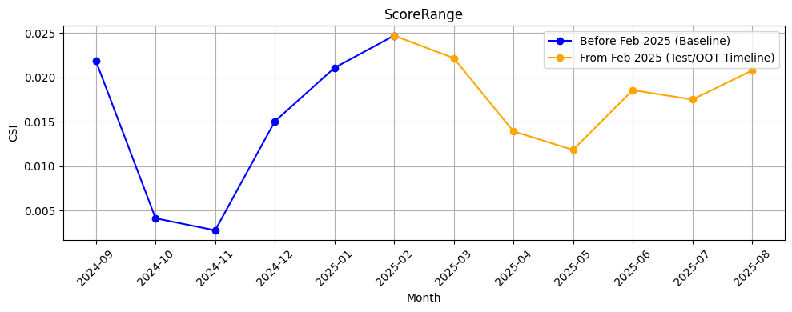
Rank# 3: ScoreRange(5 / 5) - Feature CSI Analysis <Applied>​
Baseline period: Sep’2024 to Jan’2025.
CSI for ScoreRange dropped from ~0.022 in Sep’24 to ~0.003 in Nov, then climbed steadily to ~0.025 by Jan’25, showing mild fluctuation but well below drift threshold.
In the Test/OOT period (Feb–Jul’25), CSI declined from ~0.025 to ~0.012 by May, then stabilized around ~0.017–0.018. Values remain below 0.1, indicating good stability with no drift.
33

Slide 34
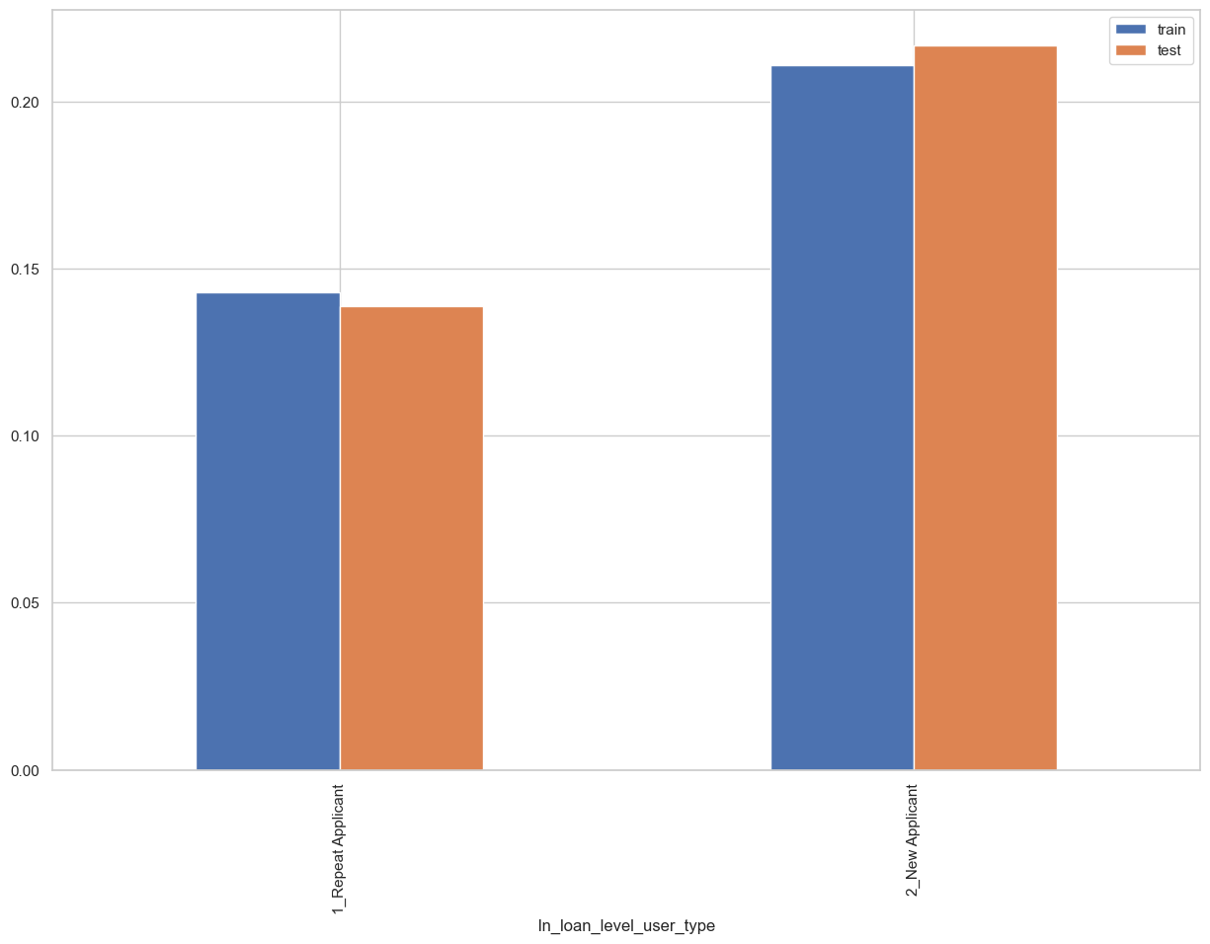
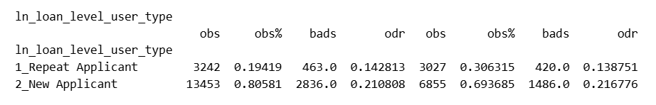
Rank# 4: ln_loan_level_user_type (1 / 4) - Performance in Train vs Test <Disbursed>
Loan level user type “New Applicant” or “Repeat Applicant”
34
Please note these are just WOE Bins, NOT the final Bins that Catboost chooses internally

Slide 35
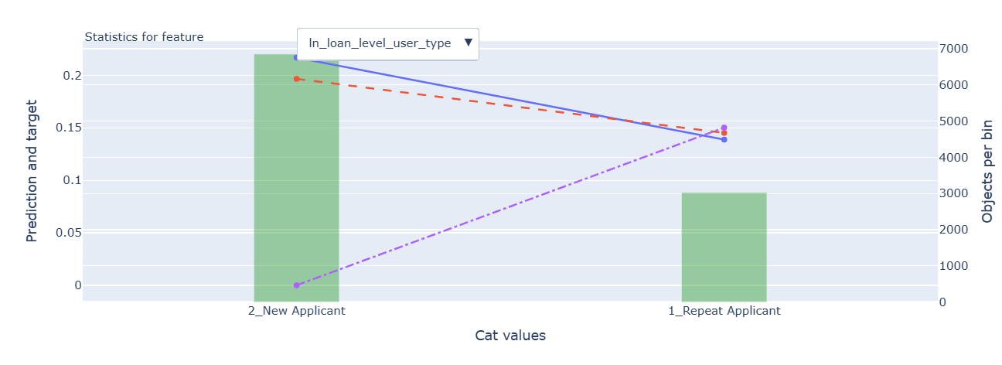
Rank# 4: ln_loan_level_user_type (2 / 4) - Feature Statistics Analysis <Disbursed>​
The red (prediction) and blue (actual target) lines show a strong alignment for "New Applicant," indicating the model effectively captures this category with high accuracy.
For "Repeat Applicant," while there is some variation in the prediction, the model still provides meaningful insights, with the red and blue lines showing a noticeable trend.
The gap between the red and purple lines for "Repeat Applicant" suggests that the feature adds value and contributes to refining predictions, especially in differentiating between applicant types
35

Slide 36
Rank# 4: ln_loan_level_user_type (3 / 4) - MoM Feature Distribution <Applied>​
month | Applied Count | Approval Rate | 2_New Applicant | 1_Repeat Applicant |  | Avg. CIC Score
2024-09 | 15406 | 19.8% | 93.42% | 6.58% |  | 0.54662
2024-10 | 12306 | 30.7% | 92.22% | 7.78% |  | 0.53066
2024-11 | 12316 | 29.5% | 91.72% | 8.28% |  | 0.53131
2024-12 | 10968 | 27.8% | 86.11% | 13.89% |  | 0.5256
2025-01 | 11640 | 28.4% | 86.75% | 13.25% |  | 0.52092
2025-02 | 10830 | 28.9% | 87.72% | 12.28% |  | 0.52169
2025-03 | 9577 | 29.4% | 83.27% | 16.73% |  | 0.52142
2025-04 | 9160 | 26.3% | 83.18% | 16.82% |  | 0.52051
2025-05 | 9531 | 28.7% | 81.69% | 18.31% |  | 0.51152
2025-06 | 11380 | 28.2% | 83.39% | 16.61% |  | 0.51759
2025-07 | 11298 | 26.6% | 83.73% | 16.27% |  | 0.51914
2025-08 | 10618 | 28.2% | 84.11% | 15.89% |  | 0.51919
The New Applicant segment remains the majority across all months, consistently above 80%, with a gradual decrease from 93.42% in Sep 2024 to 83.73% in Jul 2025.
The Repeat Applicant share gradually increases from 6.58% in Sep 2024 to 16.73% in Mar 2025, then stays stable around 16-18% in subsequent months, indicating a consistent shift.
The overall change in both segments is smooth and controlled, reflecting a reliable trend over time, with no abrupt spikes or drops
36

Slide 37
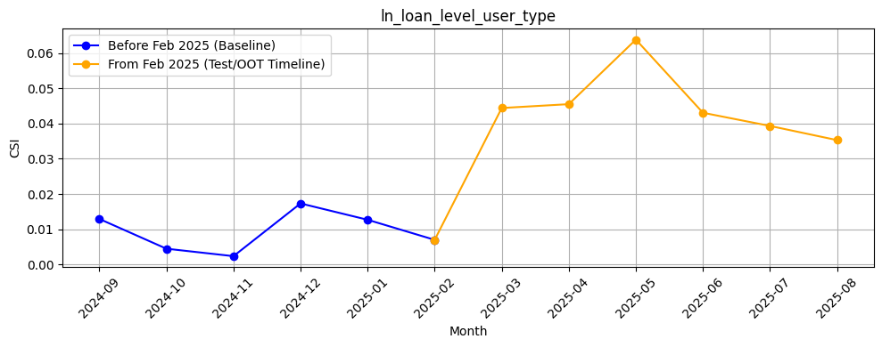
Rank# 4: ln_loan_level_user_type (4 / 4) - Feature CSI Analysis <Applied>​
Baseline period: Sep’2024 to Jan’2025.
CSI for ln_loan_level_user_type stayed very low (~0.01–0.02) with only minor fluctuations, reflecting strong stability.In the Test/OOT period (Feb–Jul’25), CSI increased to ~0.045–0.064 before easing to ~0.039 by Jul’25, but values consistently stayed well below the 0.1 threshold, confirming good stability with only mild variation.
37

Slide 38
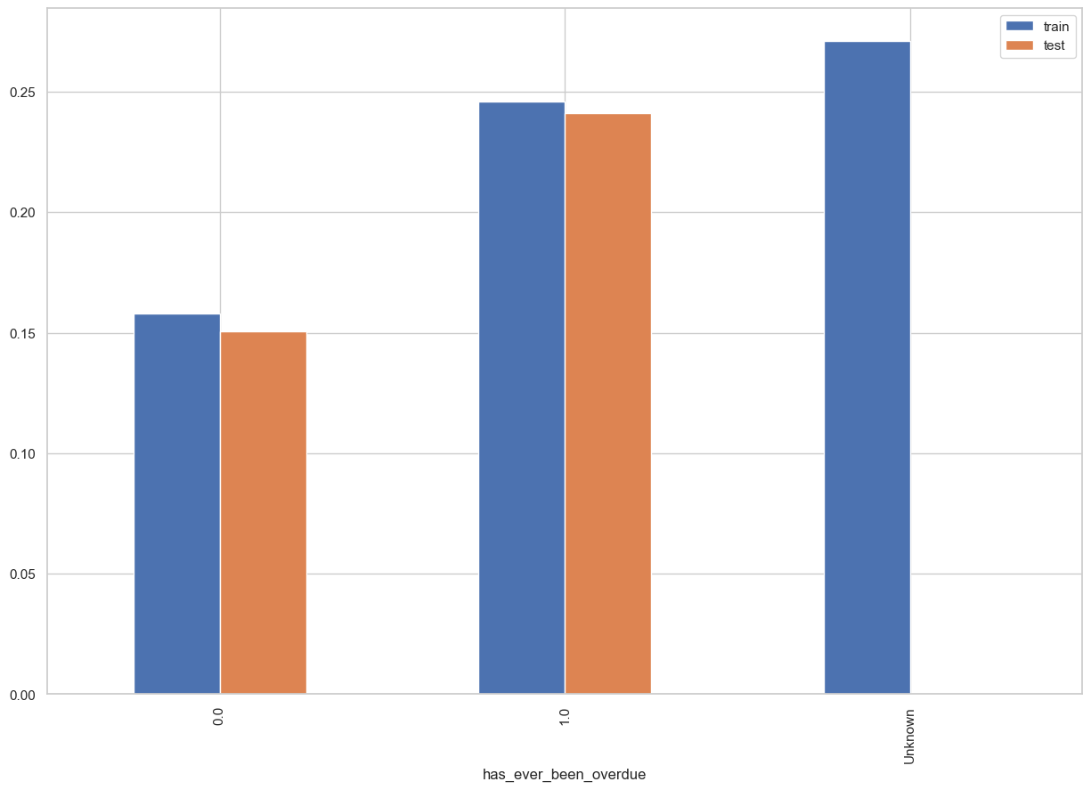
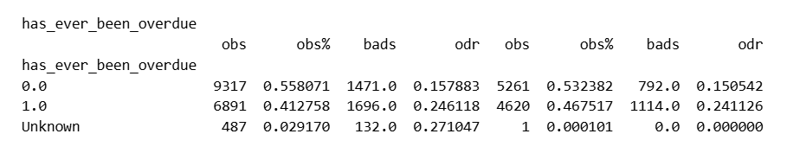
Rank# 5: has_ever_been_overdue (1 / 5) - Performance in Train vs Test <Disbursed>
1 if the account has ever had an overdue contract, otherwise 0.
38
Please note these are just WOE Bins, NOT the final Bins that Catboost chooses internally

Slide 39
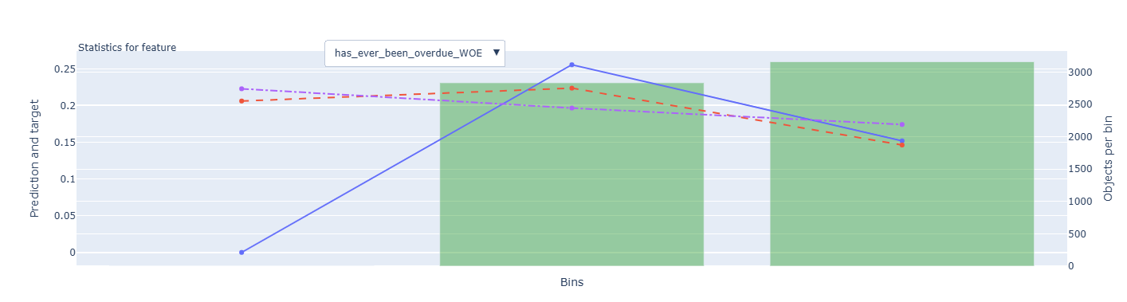
Rank# 5: has_ever_been_overdue (2 / 5) - Feature Statistics Analysis <Disbursed>​
Red line aligns reasonably well with the blue line, especially in the middle and higher bins. This shows the model is effectively capturing the overall trend of the feature.
The red-purple gap indicates this feature has moderate predictive value. The model's predictions are better than a simple baseline, confirming that the feature contributes to accuracy.
39

Slide 40
Rank# 5: has_ever_been_overdue (3 / 5) - MoM Feature Distribution <Applied>​
month | Applied Count | Approval Rate | 0 | 1 | Unknown |  | Avg. CIC Score
2024-09 | 15406 | 19.8% | 51.07% | 37.42% | 11.51% |  | 0.54662
2024-10 | 12306 | 30.7% | 53.27% | 38.58% | 8.15% |  | 0.53066
2024-11 | 12316 | 29.5% | 52.74% | 38.21% | 9.05% |  | 0.53131
2024-12 | 10968 | 27.8% | 50.90% | 41.28% | 7.81% |  | 0.5256
2025-01 | 11640 | 28.4% | 52.86% | 38.60% | 8.54% |  | 0.52092
2025-02 | 10830 | 28.9% | 51.27% | 40.53% | 8.20% |  | 0.52169
2025-03 | 9577 | 29.4% | 51.82% | 40.33% | 7.85% |  | 0.52142
2025-04 | 9160 | 26.3% | 53.28% | 38.85% | 7.87% |  | 0.52051
2025-05 | 9531 | 28.7% | 55.47% | 36.80% | 7.73% |  | 0.51152
2025-06 | 11380 | 28.2% | 53.18% | 39.60% | 7.21% |  | 0.51759
2025-07 | 11298 | 26.6% | 52.02% | 41.13% | 6.85% |  | 0.51914
2025-08 | 10618 | 28.2% | 50.84% | 41.71% | 7.45% |  | 0.51919
The 0 category remains dominant, consistently above 50% throughout, showing a stable distribution without major shifts.
The 1 category exhibits a gradual and controlled increase from 37.42% in Sep 2024 to 41.13% in Jul 2025, indicating a smooth transition without abrupt jumps.
The Missing category remains minimal and stable, fluctuating between 6-11%, reinforcing the overall reliability and stability of the feature.
40

Slide 41
Rank# 5: has_ever_been_overdue (4 / 5) - MoM Feature Distribution <Applied> <User Type wise>​
has_ever_been_overdue - New Applicant
month | Applied Count | Approval Rate | 0 | 1 | Unknown |  | Avg. CIC Score
2024-09 | 14392 | 17.8% | 50.19% | 37.60% | 12.21% |  | 0.55412
2024-10 | 11348 | 28.4% | 52.36% | 38.89% | 8.75% |  | 0.53885
2024-11 | 11296 | 27.5% | 51.97% | 38.37% | 9.67% |  | 0.53941
2024-12 | 9444 | 23.6% | 49.41% | 41.68% | 8.92% |  | 0.53985
2025-01 | 10098 | 24.2% | 51.97% | 38.49% | 9.54% |  | 0.53411
2025-02 | 9500 | 25.1% | 50.05% | 40.77% | 9.18% |  | 0.53446
2025-03 | 7975 | 24.0% | 51.10% | 39.65% | 9.25% |  | 0.53894
2025-04 | 7619 | 20.9% | 52.82% | 38.02% | 9.16% |  | 0.53747
2025-05 | 7786 | 22.3% | 54.94% | 35.77% | 9.29% |  | 0.53004
2025-06 | 9490 | 23.0% | 52.56% | 39.05% | 8.39% |  | 0.53473
2025-07 | 9460 | 20.7% | 51.44% | 40.69% | 7.88% |  | 0.53564
2025-08 | 8931 | 19.6% | 50.90% | 40.50% | 8.60% |  | 0.53535
has_ever_been_overdue - Repeat Applicant
month | Applied Count | Approval Rate | 0 | 1 | Unknown |  | Avg. CIC Score
2024-09 | 1014 | 49.4% | 63.61% | 34.81% | 1.58% |  | 0.44008
2024-10 | 958 | 58.5% | 63.99% | 34.97% | 1.04% |  | 0.43368
2024-11 | 1020 | 51.6% | 61.27% | 36.47% | 2.25% |  | 0.44165
2024-12 | 1524 | 53.5% | 60.17% | 38.85% | 0.98% |  | 0.43729
2025-01 | 1542 | 55.4% | 58.69% | 39.30% | 2.01% |  | 0.43457
2025-02 | 1330 | 56.4% | 60.00% | 38.80% | 1.20% |  | 0.43043
2025-03 | 1602 | 56.3% | 55.43% | 43.70% | 0.87% |  | 0.43417
2025-04 | 1541 | 53.4% | 55.55% | 42.96% | 1.49% |  | 0.43667
2025-05 | 1745 | 57.2% | 57.82% | 41.38% | 0.80% |  | 0.42893
2025-06 | 1890 | 54.8% | 56.30% | 42.38% | 1.32% |  | 0.43152
2025-07 | 1838 | 56.9% | 55.01% | 43.42% | 1.58% |  | 0.4342
2025-08 | 1687 | 73.6% | 50.50% | 48.13% | 1.36% |  | 0.43364
The "has_ever_been_overdue" feature for new applicants shows stable fluctuations over the months, with values consistently between 49% and 54% for "0" (not overdue) and 35% to 40% for "1" (overdue).
There are no significant variations observed, indicating predictable behavior of applicants' overdue history, making it reliable for use in modeling over time.
The "has_ever_been_overdue" feature for repeat applicants demonstrates slight fluctuations in the proportion of applicants with overdue history (denoted by "1"), ranging from 34% to 43% over the months.
The data shows a gradual shift towards a higher percentage of overdue records, with values stabilizing around 41% to 43% by mid-2025, indicating a predictable and stable trend for repeat applicants.
41

Slide 42
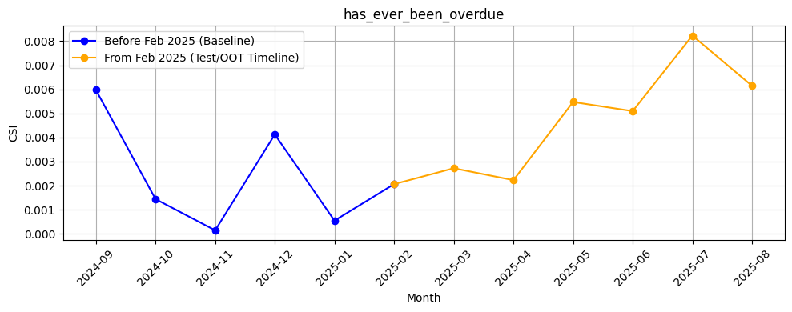
Rank# 5: has_ever_been_overdue (5 / 5) - Feature CSI Analysis <Applied>​
Baseline period (Sep’24–Jan’25)
CSI remained extremely low (~0.000–0.006), showing strong stability with minimal variation.
Test/OOT period (Feb–Jul’25):CSI showed a gradual upward trend, moving from ~0.002 in Feb to ~0.008 in Jul. Despite the increase, all values are comfortably below the 0.1 threshold, confirming that the feature remains highly stable with only mild, healthy variation.
42

Slide 43
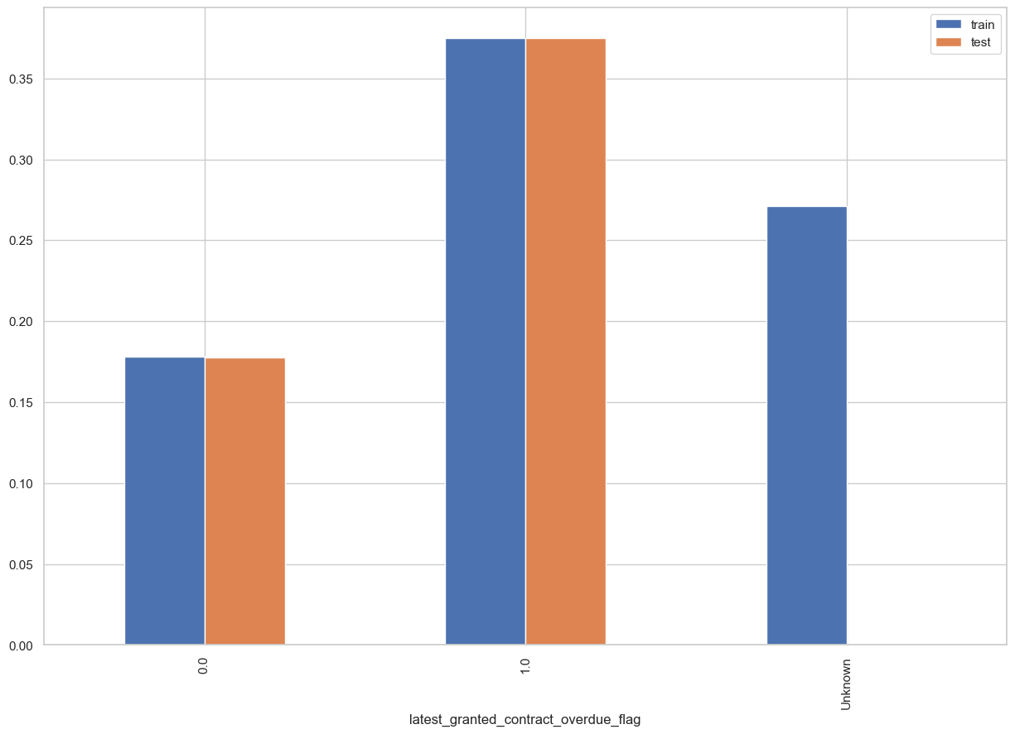
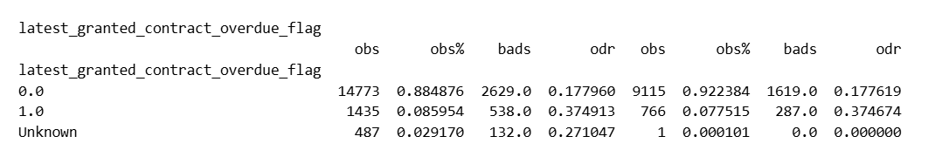
Rank# 6: latest_granted_contract_overdue_flag (1 / 4) - Performance in Train vs Test <Disbursed>
Indicates if the most recent granted contract was overdue (1 = Yes, 0 = No).
43
Please note these are just WOE Bins, NOT the final Bins that Catboost chooses internally

Slide 44
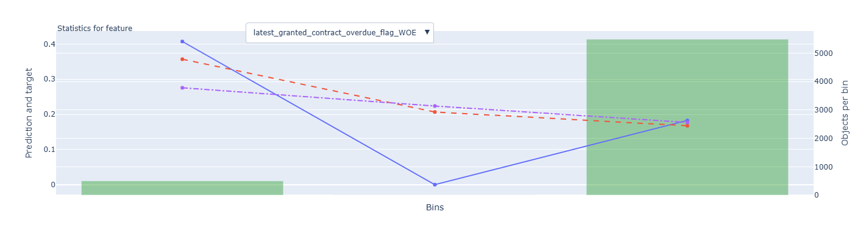
Rank# 6: latest_granted_contract_overdue_flag (2 /4) - Feature Statistics Analysis <Disbursed>​
The red (prediction) and blue (actual target) lines show a good overall alignment, demonstrating that the model effectively captures the general trend of the feature with high accuracy.
The model's predictions are particularly strong in the higher bins, where the two lines converge closely.
44

Slide 45
Rank# 6: latest_granted_contract_overdue_flag (3 / 4) - MoM Feature Distribution <Applied>​
month | Applied Count | Approval Rate | 0 | 1 | Unknown |  | Avg. CIC Score
2024-09 | 15406 | 19.8% | 71.87% | 16.62% | 11.51% |  | 0.54662
2024-10 | 12306 | 30.7% | 78.21% | 13.64% | 8.15% |  | 0.53066
2024-11 | 12316 | 29.5% | 76.68% | 14.27% | 9.05% |  | 0.53131
2024-12 | 10968 | 27.8% | 77.60% | 14.59% | 7.81% |  | 0.5256
2025-01 | 11640 | 28.4% | 78.39% | 13.07% | 8.54% |  | 0.52092
2025-02 | 10830 | 28.9% | 78.48% | 13.32% | 8.20% |  | 0.52169
2025-03 | 9577 | 29.4% | 78.89% | 13.26% | 7.85% |  | 0.52142
2025-04 | 9160 | 26.3% | 79.52% | 12.61% | 7.87% |  | 0.52051
2025-05 | 9531 | 28.7% | 81.39% | 10.88% | 7.73% |  | 0.51152
2025-06 | 11380 | 28.2% | 80.59% | 12.20% | 7.21% |  | 0.51759
2025-07 | 11298 | 26.6% | 79.96% | 13.19% | 6.85% |  | 0.51914
2025-08 | 10618 | 28.2% | 79.75% | 12.80% | 7.45% |  | 0.51919
The 0 category remains the dominant segment, consistently above 70%, showing a stable distribution with minimal fluctuations.
The 1 category exhibits a gradual decline, from 16.62% in Sep 2024 to 13.19% in Jul 2025, indicating a controlled and steady shift.
The Missing category stays minimal and stable, fluctuating between 6-11%, reinforcing the overall reliability and consistency of the feature distribution.
Overall, the feature shows strong stability and gradual shifts over time, with no abrupt changes, making it highly reliable and suitable for modeling.
45

Slide 46
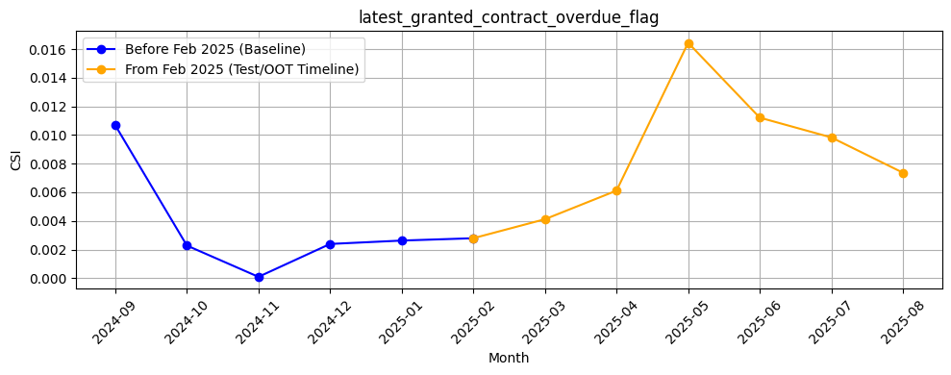
Rank# 6: latest_granted_contract_overdue_flag (4 / 4) - Feature CSI Analysis <Applied>​
Baseline period (Sep’24–Jan’25): CSI stayed very low, mostly between ~0.0 and ~0.01, reflecting excellent feature stability.
Test/OOT period (Feb–Jul’25):CSI showed a gradual rise from ~0.003 in Feb to ~0.016 in May, then softened to ~0.010 by Jul. Importantly, all values are far below the 0.1 threshold, confirming that the feature remains highly stable, with the healthy variations indicating responsiveness to recent portfolio dynamics.
46

Slide 47
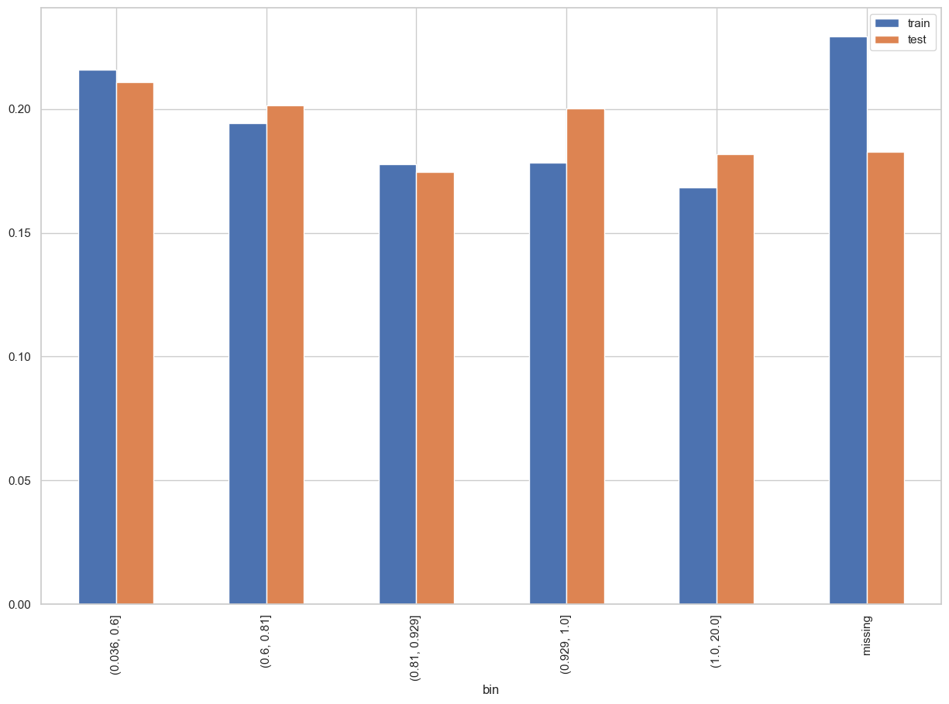
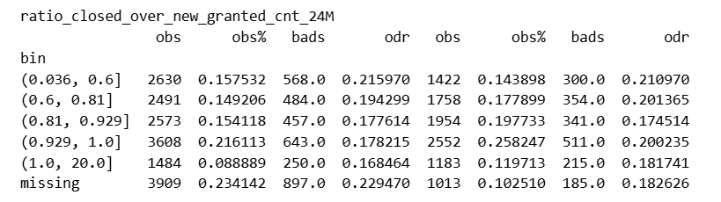
Rank# 7: ratio_closed_over_new_granted_cnt_24M (1 / 5) - Performance in Train vs Test <Disbursed>
Ratio of the number of contracts closed in the last 6 months to the number of new contracts granted in the last 24 months.
47
Please note these are just WOE Bins, NOT the final Bins that Catboost chooses internally

Slide 48
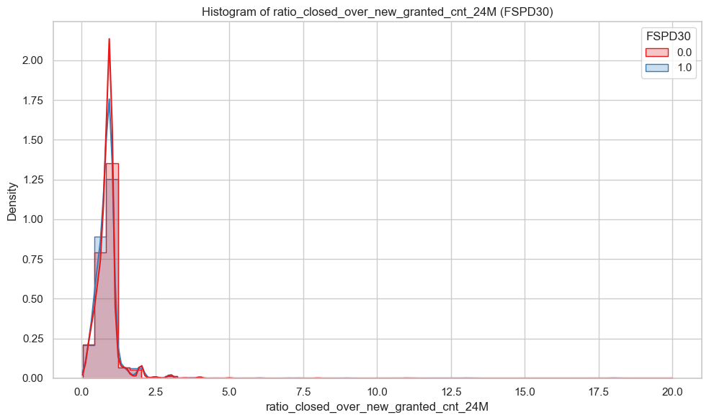
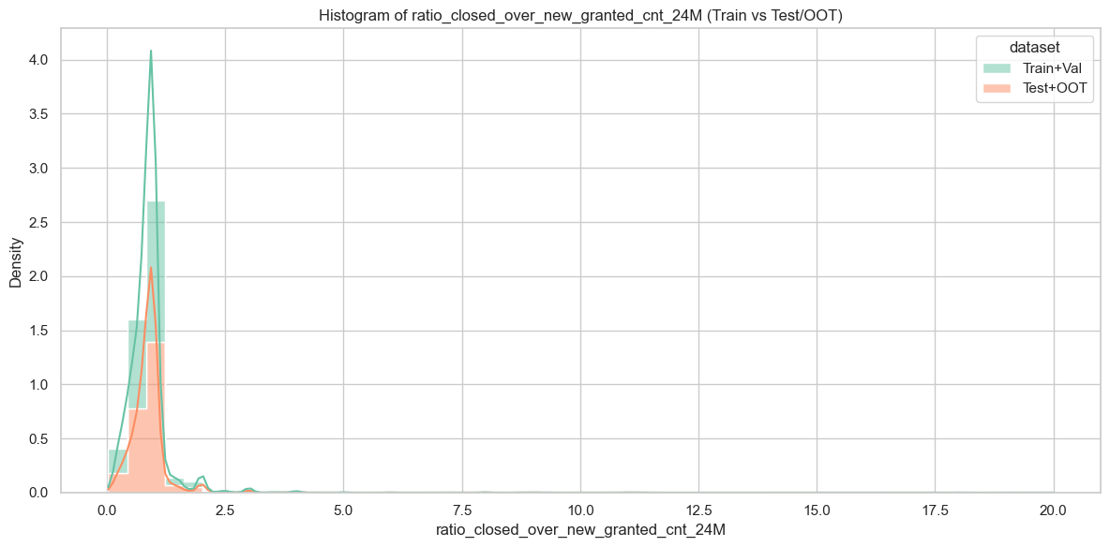
Rank# 7: ratio_closed_over_new_granted_cnt_24M (2 / 5) - Histogram <Disbursed>
Both Train+Val (green) and Test+OOT (orange) have very similar, heavily right-skewed distributions. Most customers have a ratio between 0 and 2. While Test+OOT has a slightly lower density at its peak, the overall shape and trend are consistent, confirming good alignment between the datasets.
Both good (red) and bad (blue) customers are concentrated in the 0–2 range, but their patterns differ. Good customers show a sharper peak around 1.0–1.5, while bad customers are more evenly spread in the lower range. This suggests that a higher closure-to-new ratio is more characteristic of good customers.
48

Slide 49
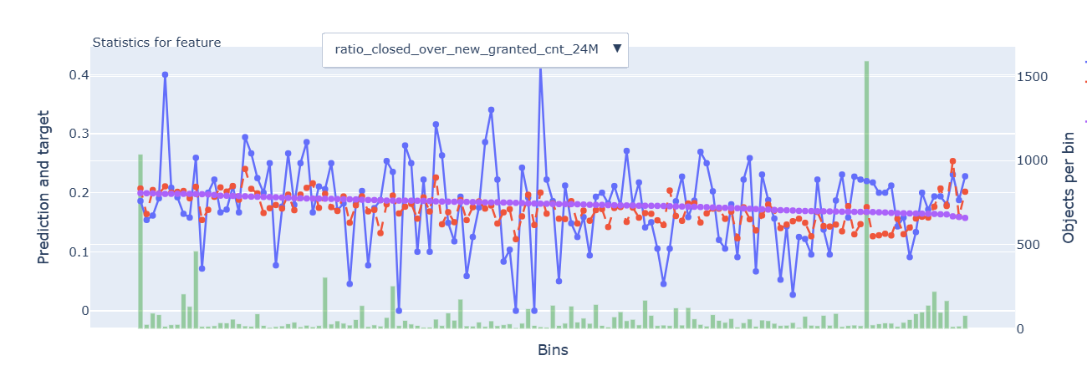
Rank# 7: ratio_closed_over_new_granted_cnt_24M (3 / 5) - Feature Statistics Analysis <Disbursed>​
The red (prediction) and blue (actual) lines align well, indicating the model accurately captures the feature's pattern.
The small gap between the red and purple lines shows the feature adds value to prediction accuracy.
An upward trend in the red and blue lines at higher bins confirms that the model effectively captures the increasing risk associated with a higher ratio of closed to new contracts.
49

Slide 50
Rank# 7: ratio_closed_over_new_granted_cnt_24M (4 / 5) - MoM Feature Distribution <Applied>​
month | ratio_closed_over_new_granted_cnt_24M |  | Avg. CIC Score
2024-09 | 0.89 |  | 0.54662
2024-10 | 0.88 |  | 0.53066
2024-11 | 0.92 |  | 0.53131
2024-12 | 0.93 |  | 0.5256
2025-01 | 0.93 |  | 0.52092
2025-02 | 0.93 |  | 0.52169
2025-03 | 0.91 |  | 0.52142
2025-04 | 0.92 |  | 0.52051
2025-05 | 0.92 |  | 0.51152
2025-06 | 0.92 |  | 0.51759
2025-07 | 0.91 |  | 0.51914
2025-08 | 0.93 |  | 0.51919
The ratio remains consistent across months, fluctuating between 0.88 and 0.93, reflecting a stable and controlled trend.
There are minor fluctuations, with values staying mostly around 0.92, indicating no significant changes or spikes.
The feature demonstrates strong stability, making it reliable for modeling with a predictable and consistent distribution over time.
50

Slide 51
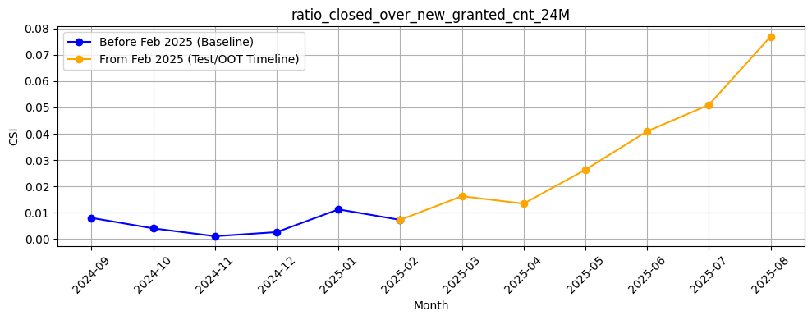
Rank# 7: ratio_closed_over_new_granted_cnt_24M (5 / 5) - Feature CSI Analysis <Applied>​
Baseline period (Sep’24–Jan’25):CSI was consistently low, mostly below 0.01, reflecting excellent stability in feature behavior during this phase.
Test/OOT period (Feb–Jul’25):CSI started at ~0.007 in Feb and showed a gradual rise, reaching ~0.05 by Jul. Despite the increase, values remain well under the 0.1 threshold, confirming that the feature is stable. The upward trend highlights its sensitivity in capturing recent portfolio changes, which adds value without indicating drift risk.
51

Slide 52
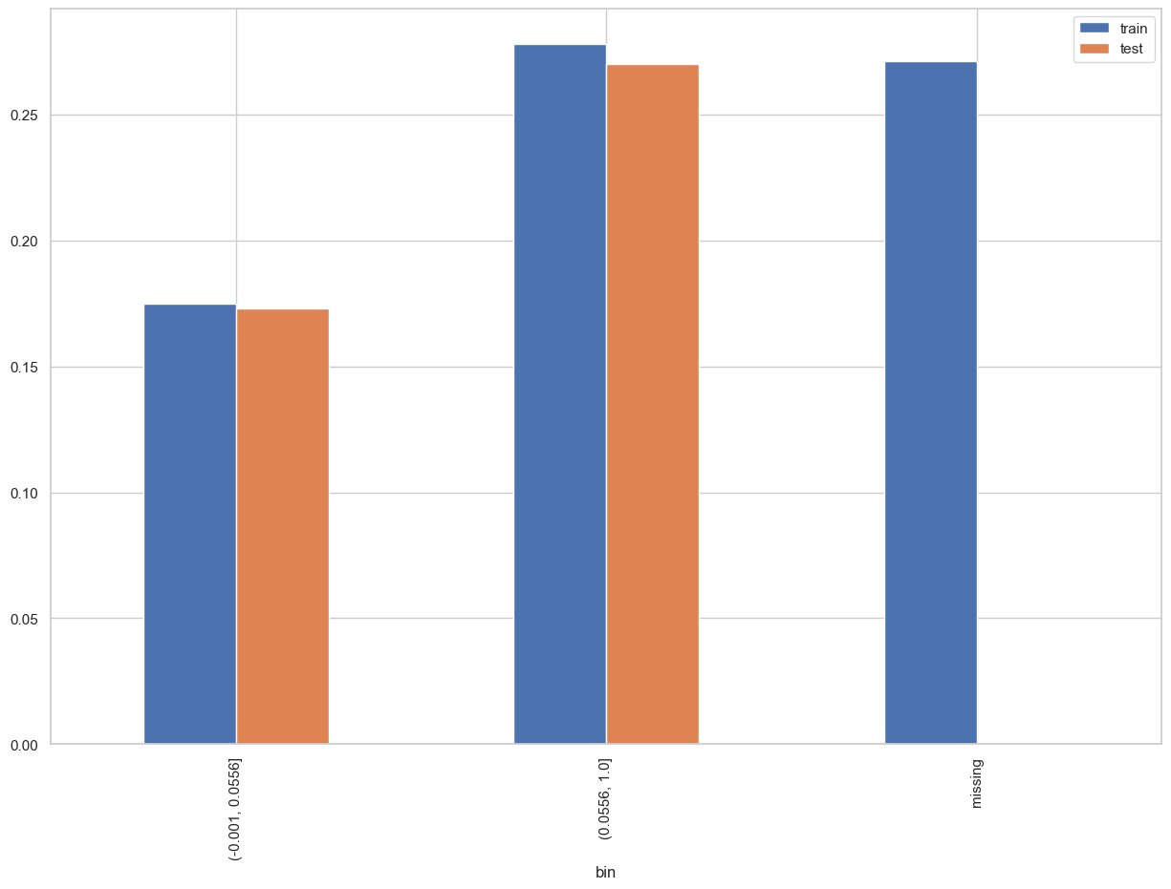
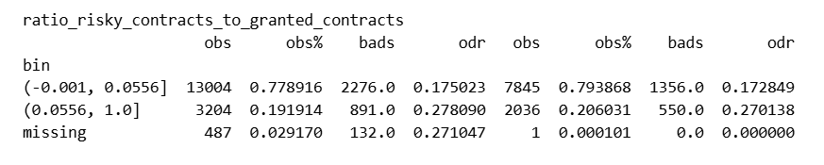
Rank# 8: ratio_risky_contracts_to_granted_contracts(1 / 5) - Performance in Train vs Test <Disbursed>
Ratio of the number of risky contracts to the number of contracts granted.
52
Please note these are just WOE Bins, NOT the final Bins that Catboost chooses internally

Slide 53
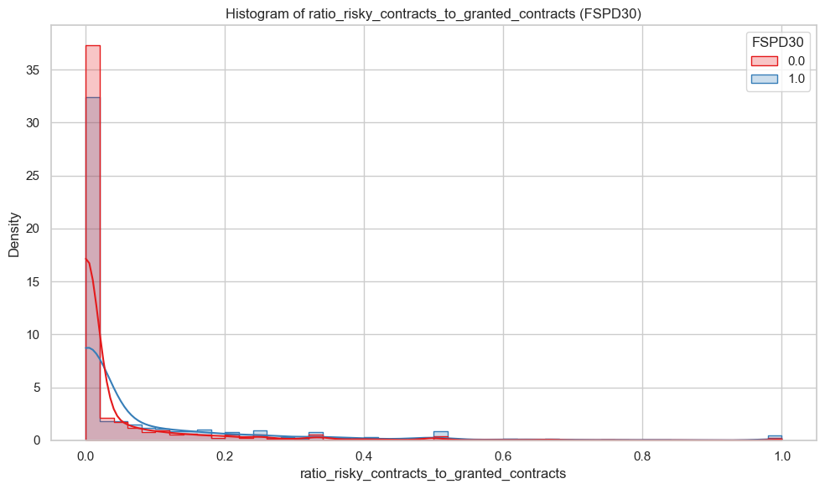
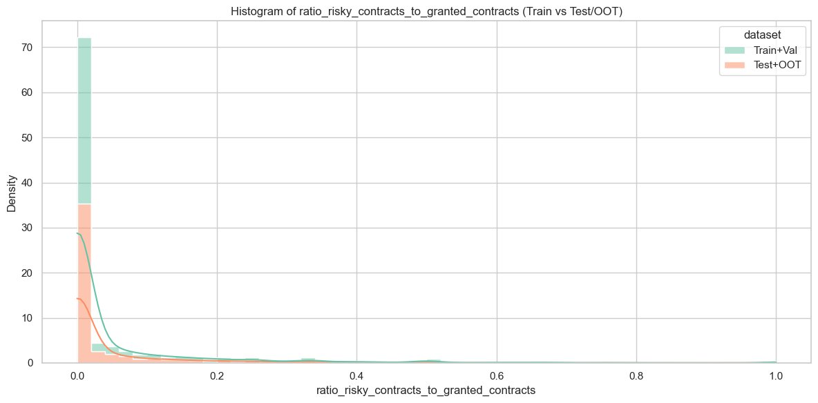
Rank# 8: ratio_risky_contracts_to_granted_contracts (2 / 5) - Histogram <Disbursed>
The vast majority of customers have a very low ratio (close to 0). The shape is heavily right-skewed, with only a few customers having a higher proportion of risky contracts. Test+OOT (orange) closely follows Train+Val (green), showing strong alignment and minimal distribution drift.
Both groups peak sharply near 0, but: Bad customers (blue) show slightly higher density spreading into 0.05–0.2. Good customers (red) remain more tightly concentrated at the lowest-risk zone. This indicates a clear behavioral separation around risky contract exposure.
53

Slide 54
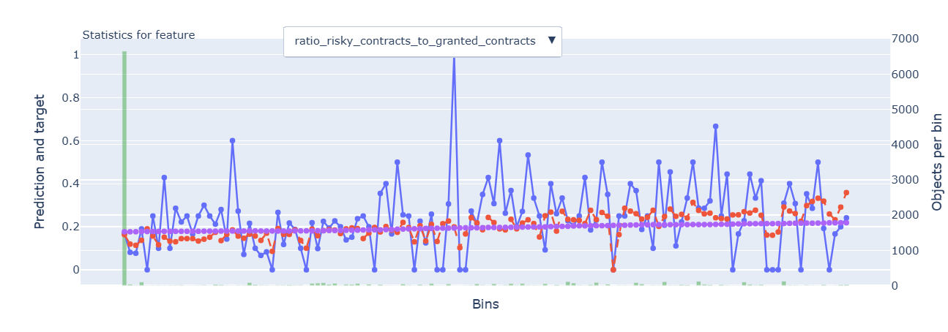
Rank# 8: ratio_risky_contracts_to_granted_contracts(3 / 5) - Feature Statistics Analysis <Disbursed>​
The red line closely follows the blue line, indicating good model calibration across bins.
The purple line is skewed towards lower bins, meaning most users have fewer granted contracts.
A clear red–blue gap in lower bins shows the model assigns higher risk to those segments, highlighting this feature’s predictive power.
54

Slide 55
Rank# 8: ratio_risky_contracts_to_granted_contracts(4 / 5) - MoM Feature Distribution <Applied>​
month | ratio_risky_contracts_to_granted_contracts |  | Avg. CIC Score
2024-09 | 0.08 |  | 0.54662
2024-10 | 0.07 |  | 0.53066
2024-11 | 0.08 |  | 0.53131
2024-12 | 0.08 |  | 0.5256
2025-01 | 0.08 |  | 0.52092
2025-02 | 0.09 |  | 0.52169
2025-03 | 0.08 |  | 0.52142
2025-04 | 0.07 |  | 0.52051
2025-05 | 0.07 |  | 0.51152
2025-06 | 0.07 |  | 0.51759
2025-07 | 0.07 |  | 0.51914
2025-08 | 0.06 |  | 0.51919
The ratio of risky contracts remains stable, fluctuating between 0.07 and 0.09, with a slight dip in Apr 2025.
Monthly changes are gradual, showing no sudden spikes or noise.
The feature is consistently distributed and predictable, making it reliable for modeling.
55

Slide 56
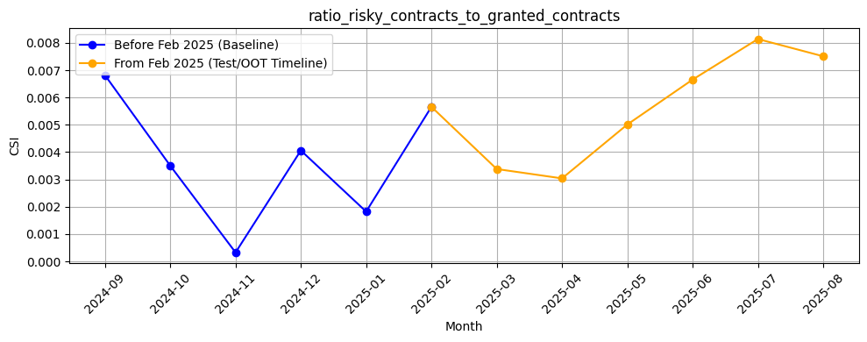
Rank# 8: ratio_risky_contracts_to_granted_contracts(5 / 5) - Feature CSI Analysis <Applied>​
Baseline period (Sep’24–Jan’25):CSI values were very low (mostly <0.01), showing excellent stability and consistent feature behavior across months.
Test/OOT period (Feb–Jul’25):CSI began at ~0.006 in Feb, slightly dipped in Mar–Apr, then steadily rose to ~0.008 by Jul. The movement remains well within the 0.1 threshold, confirming stable performance
56

Slide 57
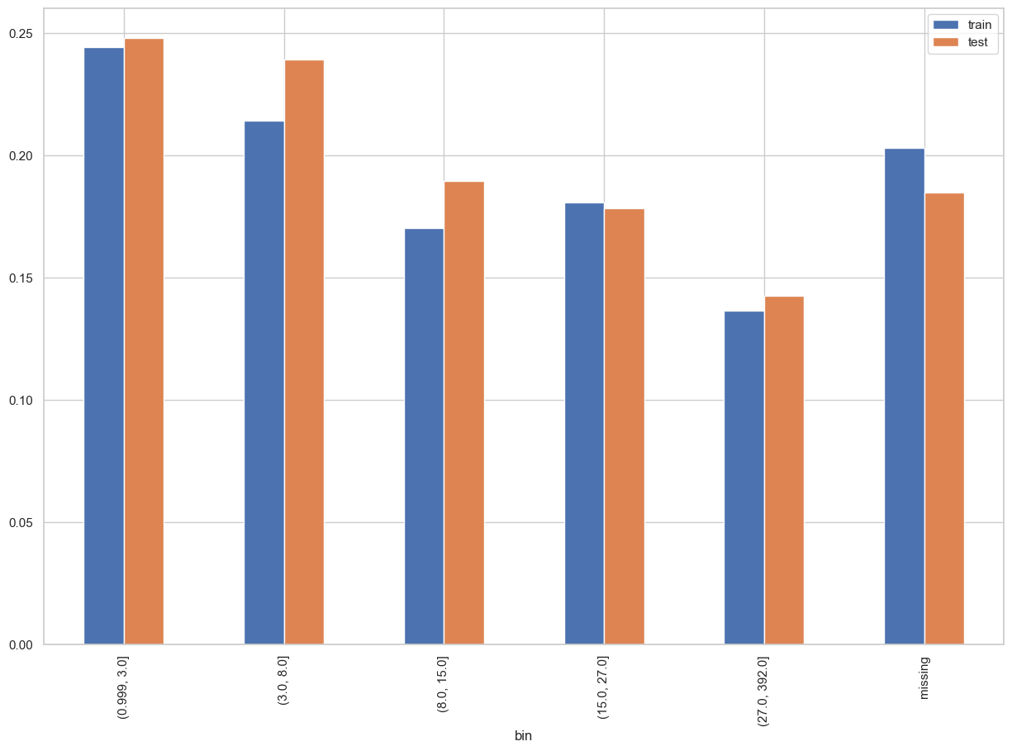
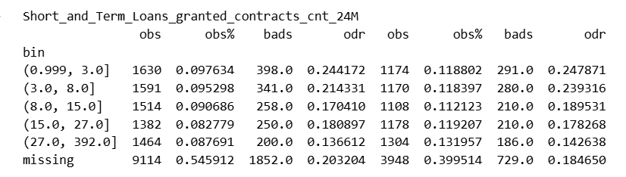
Rank# 9: Short_and_Term_Loans_granted_contracts_cnt_24M (1 / 4) - Performance in Train vs Test <Disbursed>
Count of Short and Term Loans granted in the last 24 months.​​
57
Please note these are just WOE Bins, NOT the final Bins that Catboost chooses internally

Slide 58
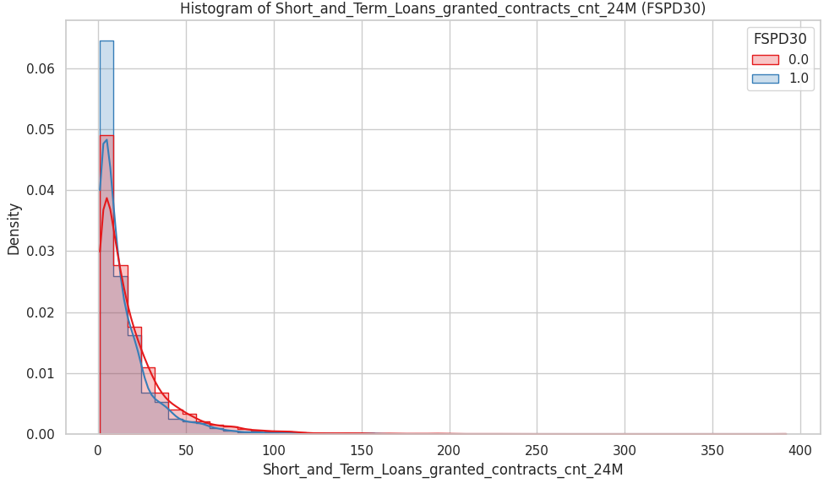

Rank# 9 : Short_and_Term_Loans_granted_contracts_cnt_24M (2 / 5) – Histogram <Disbursed>
Both Train_val (green) and Test_OOT (orange) show a highly right-skewed distribution, with most values concentrated at the lower end (0–50 loans). Despite Test_OOT having slightly lower densities at the peak, the overall shape and trend are consistent, confirming good dataset alignment. Rare extreme values (up to 400) are also present.
Both groups are concentrated at the very low end (0–10 loans). Bad customers (blue) show a slightly sharper density at these lowest values. Good customers (red) spread more gradually across higher loan counts. This suggests broader short-term loan activity is more common among good customers.
58

Slide 59

Rank# 9: Short_and_Term_Loans_granted_contracts_cnt_24M (3 / 5) - Feature Statistics Analysis <Disbursed>​
The red (prediction) and blue (actual target) lines are quite close across most bins, indicating that the model is capturing the overall pattern of this feature effectively.
The small gap between the red and purple lines suggests that the feature contributes some predictive value, but with moderate impact.
The sharp peak in the blue line at the far right indicates a specific behavior that the model may not fully capture, suggesting the feature may have limited relevance for predicting extreme cases.
59

Slide 60
Rank# 9: Short_and_Term_Loans_granted_contracts_cnt_24M (4 / 5) - MoM Feature Distribution <Applied>​
month | Short_and_Term_Loans_granted_contracts_cnt_24M |  | Avg. CIC Score
2024-09 | 11.3 |  | 0.54662
2024-10 | 12.65 |  | 0.53066
2024-11 | 12.89 |  | 0.53131
2024-12 | 14.04 |  | 0.5256
2025-01 | 14.39 |  | 0.52092
2025-02 | 14.67 |  | 0.52169
2025-03 | 14.01 |  | 0.52142
2025-04 | 14.5 |  | 0.52051
2025-05 | 17.04 |  | 0.51152
2025-06 | 17.84 |  | 0.51759
2025-07 | 18.76 |  | 0.51914
2025-08 | 18.63 |  | 0.51919
The count of short and term loans granted steadily increases from 11.3 in Sep 2024 to 18.76 in Jul 2025, with gradual growth each month.
Monthly changes are consistent, with no sharp spikes or drops, indicating a smooth upward trend.
The feature shows a predictable and steady growth, making it reliable for modeling and reflecting strong distributional stability.
60

Slide 61

Rank# 9: Short_and_Term_Loans_granted_contracts_cnt_24M (5 / 5) - Feature CSI Analysis <Applied>​
Baseline period: Sep’2024 to Jan’2025.
CSI values stayed very low and stable. In the test/OOT period (from Feb’25), values started near baseline levels, stayed consistent for a few months, and then gradually increased to ~0.03 by Jul’25. Overall, both baseline stability and test/OOT progression remain within a smooth trend.
61

Slide 62


Rank# 10: flg_zero_non_granted_ever(1 / 4) - Performance in Train vs Test <Disbursed>
A flag (likely 1/0) that indicates whether the customer never had any loan applications rejected (i.e., non-granted contracts = 0).​
62
Please note these are just WOE Bins, NOT the final Bins that Catboost chooses internally

Slide 63

Rank# 10: flg_zero_non_granted_ever(2 / 4) - Feature Statistics Analysis <Disbursed>​
The red (prediction) and blue (actual target) lines show clear differentiation between the two categories, with a higher prediction for the "0" category and a lower prediction for the "1" category.
The alignment of the red and blue lines in the "0" category suggests the model is accurately capturing the behavior for users with no granted loans.
The red and purple lines for the "1" category show a more pronounced separation, indicating the feature helps in predicting the default behavior for those with granted loans.
63

Slide 64
Rank# 10: flg_zero_non_granted_ever(3 / 4) - MoM Feature Distribution <Applied>​
month | Applied Count | Approval Rate | 0 | 1 |  | Avg. CIC Score
2024-09 | 15406 | 19.8% | 69.74% | 30.26% |  | 0.54662
2024-10 | 12306 | 30.7% | 70.84% | 29.16% |  | 0.53066
2024-11 | 12316 | 29.5% | 73.88% | 26.12% |  | 0.53131
2024-12 | 10968 | 27.8% | 76.35% | 23.65% |  | 0.5256
2025-01 | 11640 | 28.4% | 78.99% | 21.01% |  | 0.52092
2025-02 | 10830 | 28.9% | 78.99% | 21.01% |  | 0.52169
2025-03 | 9577 | 29.4% | 81.58% | 18.42% |  | 0.52142
2025-04 | 9160 | 26.3% | 82.88% | 17.12% |  | 0.52051
2025-05 | 9531 | 28.7% | 83.54% | 16.46% |  | 0.51152
2025-06 | 11380 | 28.2% | 85.35% | 14.65% |  | 0.51759
2025-07 | 11298 | 26.6% | 85.50% | 14.50% |  | 0.51914
2025-08 | 10618 | 28.2% | 85.21% | 14.79% |  | 0.51919
The 0 category steadily decreases from 69.74% in Sep 2024 to 85.50% in Jul 2025, with consistent growth each month.
Monthly changes are gradual, with no sharp spikes or sudden shifts, reflecting a steady and predictable trend.
The feature shows stable and controlled changes, making it reliable for modeling with strong distributional stability.
64

Slide 65

Rank# 10: flg_zero_non_granted_ever(4 / 4) - Feature CSI Analysis <Applied>​
Baseline period: Sep’2024 to Jan’2025.CSI for flg_zero_non_granted_ever remained consistently low and stable during the baseline period, indicating strong feature stability.
In the Test/OOT period (Feb to Jul 2025), CSI values showed an increasing trend, still staying well below the typical 0.1 threshold. The model performance remained stable despite the minor shift.
65

Slide 66


Rank# 11: Personal_Loans_granted_contracts_amt_24M (1 / 5) - Performance in Train vs Test <Disbursed>
Total amount of Personal Loans granted in the last 24 months.​
66
Please note these are just WOE Bins, NOT the final Bins that Catboost chooses internally

Slide 67


Rank# 11: Personal_Loans_granted_contracts_amt_24M (2 / 5) – Histogram <Disbursed>
Both Train+Val (green) and Test+OOT (orange) are heavily right-skewed, with the majority of loan amounts clustered near zero. There's good alignment between the datasets, with Test+OOT showing a slightly broader spread in the mid-range. Extreme outliers exist (up to ~5), but they are very rare and do not distort the general shape.
Both groups are concentrated at lower loan amounts with sharp density near zero. Bad customers (blue) peak slightly higher at the lowest values, suggesting limited personal loan exposure. Good customers (red) show a more gradual and broader spread, reflecting somewhat higher and more distributed loan activity and a subtle behavioral difference.
67

Slide 68

Rank# 11: Personal_Loans_granted_contracts_amt_24M (3 / 5) - Feature Statistics Analysis <Disbursed>​
The red (prediction) and blue (actual target) lines show close alignment across most bins, indicating that the model captures the overall pattern of the feature effectively.
The small gap between the red and purple lines suggests that the feature adds value and helps refine the model’s predictions, though with moderate impact.
There are sharp peaks and drops in the blue line, particularly in the lower bins, indicating that while the feature captures general trends, it may not fully account for extreme cases or outliers..
68

Slide 69
Rank# 11: Personal_Loans_granted_contracts_amt_24M(4 / 5) - MoM Feature Distribution <Applied>​
month | Personal_Loans_granted_contracts_amt_24M |  | Avg. CIC Score
2024-09 | 65282.03 |  | 0.54662
2024-10 | 73730.49 |  | 0.53066
2024-11 | 72660.87 |  | 0.53131
2024-12 | 86629.13 |  | 0.5256
2025-01 | 80002.73 |  | 0.52092
2025-02 | 84889.68 |  | 0.52169
2025-03 | 84755.78 |  | 0.52142
2025-04 | 73947.85 |  | 0.52051
2025-05 | 81209.12 |  | 0.51152
2025-06 | 77932.35 |  | 0.51759
2025-07 | 80640.89 |  | 0.51914
2025-08 | 75439.5 |  | 0.51919
The personal loans granted amount shows a steady increase, from 65282.03 in Sep 2024 to 86629.13 in Dec 2024, followed by slight fluctuations through 2025.
Monthly changes are gradual and smooth, with no abrupt spikes or drops, reflecting a stable upward trend.
The feature demonstrates consistent growth, making it reliable for modeling with strong distributional stability over time.
69

Slide 70

Rank# 11: Personal_Loans_granted_contracts_amt_24M(5 / 5) - Feature CSI Analysis <Applied>​
Baseline period: Sep’2024 to Jan’2025.CSI for Personal_Loans_granted_contracts_amt_24M was low and stable during the baseline period.
In the Test/OOT period (Feb to Jul 2025), the CSI showed a fluctuating upward trend, with a significant spike in July 2025 to over 0.05, indicating a clear shift in the feature distribution and suggesting data drift.
70

Slide 71


Rank# 12: CreditAvgCreditLimit ( 1 / 5) - Performance in Train vs Test <Disbursed>
Average credit limit across all credit card lines: Total Credit Limit / Total Number of Credit Card Lines.​
71
Please note these are just WOE Bins, NOT the final Bins that Catboost chooses internally

Slide 72


Rank# 12 : CreditAvgCreditLimit (2 / 5) – Histogram <Disbursed>
Both Train+Val (green) and Test+OOT (orange) show a very similar and heavily right-skewed distribution. The vast majority of customers have a low average credit limit, with values clustered near zero. The Test+OOT dataset closely mirrors the Train+Val dataset, indicating strong alignment and minimal distribution drift.
Both groups have highly right-skewed distributions concentrated at low credit limits. Bad customers (blue) show a slightly higher density at the extreme low end, while good customers (red) extend more gradually into higher ranges. This highlights that higher credit limits are more typical of good customers.
72

Slide 73

Rank# 12: CreditAvgCreditLimit(3 / 5) - Feature Statistics Analysis <Disbursed>​
The red (prediction) and blue (actual target) lines show a consistent alignment across most bins, suggesting that the model captures the general trend well for this feature.
The small gap between the red and purple lines indicates the feature adds predictive value, although the impact is moderate.
73

Slide 74
Rank# 12: CreditAvgCreditLimit(4 / 5) - MoM Feature Distribution <Applied>​
month | CreditAvgCreditLimit |  | Avg. CIC Score
2024-09 | 16185.97 |  | 0.54662
2024-10 | 22603.19 |  | 0.53066
2024-11 | 23085.36 |  | 0.53131
2024-12 | 25333.14 |  | 0.5256
2025-01 | 24848.99 |  | 0.52092
2025-02 | 26414.4 |  | 0.52169
2025-03 | 26577.01 |  | 0.52142
2025-04 | 26122.79 |  | 0.52051
2025-05 | 27972.48 |  | 0.51152
2025-06 | 26199.81 |  | 0.51759
2025-07 | 25724.42 |  | 0.51914
2025-08 | 24950.65 |  | 0.51919
The average credit limit shows a steady rise, peaking at 25330.83 in Dec 2024, then stabilizing between 24K-28K through 2025.
There are minor fluctuations, with the limit dipping slightly in Jan and Jun 2025, but the overall trend remains upward and gradual.
This indicates a consistent and progressive shift, making the feature reliable for modeling with minimal volatility.
74

Slide 75

Rank# 12: CreditAvgCreditLimit (5 / 5) - Feature CSI Analysis <Applied>​
Baseline period: Sep’2024 to Jan’2025.CSI for CreditAvgCreditLimit showed notable fluctuations during the baseline period.
In the Test/OOT period (Feb to Jul 2025), the CSI values fluctuated but remained well below the 0.02 threshold. This indicates that despite the minor shifts, the feature remained stable and there was no significant data drift.
75

Slide 76


Rank# 13: flg_zero_granted_ever (1 / 4) - Performance in Train vs Test <Disbursed>
A flag that indicates the user never had any granted loans (i.e., granted contracts = 0).​
76
Please note these are just WOE Bins, NOT the final Bins that Catboost chooses internally

Slide 77

Rank# 13: flg_zero_granted_ever (2 / 4) - Feature Statistics Analysis <Disbursed>​
The red (prediction) and blue (actual target) lines show a strong separation between the two categories.
The "0" category (no granted loans) has a lower prediction, while the "1" category (ever granted loans) has a higher prediction, reflecting the model's ability to distinguish between these groups effectively.
The alignment in category "0" confirms the model's accuracy, while the gap in category "1" indicates the feature's positive contribution to prediction.
77

Slide 78
Rank# 13: flg_zero_granted_ever (3 / 4) - MoM Feature Distribution <Applied>​
month | Applied Count | Approval Rate | 0 | 1 |  | Avg. CIC Score
2024-09 | 15406 | 19.8% | 88.49% | 11.51% |  | 0.54662
2024-10 | 12306 | 30.7% | 91.85% | 8.15% |  | 0.53066
2024-11 | 12316 | 29.5% | 90.95% | 9.05% |  | 0.53131
2024-12 | 10968 | 27.8% | 92.19% | 7.81% |  | 0.5256
2025-01 | 11640 | 28.4% | 91.46% | 8.54% |  | 0.52092
2025-02 | 10830 | 28.9% | 91.80% | 8.20% |  | 0.52169
2025-03 | 9577 | 29.4% | 92.15% | 7.85% |  | 0.52142
2025-04 | 9160 | 26.3% | 92.13% | 7.87% |  | 0.52051
2025-05 | 9531 | 28.7% | 92.27% | 7.73% |  | 0.51152
2025-06 | 11380 | 28.2% | 92.79% | 7.21% |  | 0.51759
2025-07 | 11298 | 26.6% | 93.15% | 6.85% |  | 0.51914
2025-08 | 10618 | 28.2% | 92.55% | 7.45% |  | 0.51919
The 0 category maintains a strong dominance, consistently above 88% and gradually increasing month-over-month, reflecting a stable distribution with no abrupt changes.
The 1 category shows a gradual decline from 11.51% in Sep 2024 to 6.85% in Jul 2025, indicating a smooth, controlled shift.
The overall distribution is steady and predictable, with the changes being gradual and stable, making it reliable for modeling with no sharp fluctuations.
78

Slide 79

Rank# 13: flg_zero_granted_ever (4 / 4) - Feature CSI Analysis <Applied>​
Baseline period: Sep’2024 to Jan’2025.CSI for flg_zero_granted_ever showed minor fluctuations but stayed consistently low during the baseline period.
In the Test/OOT period (Feb to Jul 2025), the CSI values showed an upward trend, peaking at over 0.007 in July 2025. This indicates a minor shift in the feature distribution but remains well within a stable range, showing no significant data drift.
79

Slide 80

THANK YOU!
​
Questions?
tonikbank.com

